Slide 1

Staff Contact Information
Lindy Lamkin, Executive Director – LindyL@kylionseye.org
Karen Hayse, KidSight Coordinator – KarenHayse@kylionseye.org
Jennifer Hunt Spurling, Communications Coordinator – JenniferHunt@kylionseye.org
Administrative Assistant – OPEN
Executive Committee Contact Information
POSITION | NAME | EMAIL | PHONE
President | Pam Elrod | pamjelrod@icloud.com | 270-779-9438
1st Vice President | Pam Powers | ppowers1122@gmail.com | 502-387-5601
2nd Vice President | Steve Pedersen | steve.pedersen@jrjnet.com | 606-301-1904
3rd Vice President | Tony Bishop | ajb362@gmail.com | 270-723-5984
Treasurer | Dale Barrett | dale.barrett@twc.com | 859-496-5516
Secretary | Mark Fietsch | mark.fietsch@edwardjones.com | 502-222-9373
Imm. Past President | Mac Ferguson | fergusonmac55@gmail.com | 859-420-6231
Council Chair | Randy Morris | lionrandymorris@gmail.com | 270-985-0490
43-K District Governor | Mike Frye | lionmikefrye@gmail.com | 502-376-9391
43-Y District Governor | April Ferguson | aprilferguson@securesolutionsky.com | 606-923-4337
Kentucky Lions Eye Foundation
301 E. Muhammad Ali Blvd.
Louisville, KY 40202
Phone:1-502-583-0564
Fax: 1-502-852-6596
WWW.KYLIONSEYE.ORG
Page 01

Slide 2
2025-2026 KLEF Trustee Contact Information
POSITION | NAME | EMAIL | PHONE
43-K Region 3 Trustee (2024-2026) | Rick Boggess | rboggess54@gmail.com | 270-316-8447
43-K Region 3 Trustee (2025-2027) | Bill Brown | browedwb@bellsouth.net | 270-508-0016
43-Y Region 4 Trustee (2024-2026) | Chuck Carlson | chuckcarlson07@gmail.com | 513-623-1255
43-Y Region 1 Trustee (2024-2026) | Sue Collins | susancollins1313@gmail.com | 502-291-1555
43-K 2nd VDG | Wayne Ebelhar | mwayneebelhar0@gmail.com | 662-347-0838
43-Y Region 3 Trustee (2025-2027) | Cynthia Ferguson | kylegalgal@yahoo.com | 859-539-0586
43-K Region 2 Trustee (2024-2026) | Mark Hanson | mhhanson2@bellsouth.net | 364-643-0384
Past President (23-24) & 43-Y 3rd VDG | Carol Hollander | kj4jaa@gmail.com | 502-343-0062
ID & Past President (20-21) | Guy Hollander | chemcomputer@gmail.com | 502-343-0061
43-Y Region 1 Trustee (2025-2027) | John Horton | johnanddarleenhorton@outlook.com | 502-593-0875
43-K Region 2 Trustee (2023-2025) | Marina Jenkins | marinajenkins1@yahoo.com | 270-977-2088
Past President (21-22) | John J. Johnson, III | jojejoiii@aol.com | 270-564-6520
43-Y Region 2 Trustee (2024-2026) | George Lonneman | liontrad@fuse.net | 859-801-3957
43-K Region 4 Trustee (2025-2027) | Vicki Madison | vickimadison717@gmail.com | 270-559-9704
PID & Past President (03-04) | Tom Matney | matneyth@aol.com | 859-613-4825
43-K 3rd VDG | Beth Morris | lionbmorris@gmail.com | 270-985-0489
43-Y 1st VDG | Lee Morrison, Jr. | wmorrison@shelterinsurance.com | 859-509-6420
PID & Past President (18-19) | Shea Nickell | sheanickell@gmail.com | 270-349-3777
43-Y Region 2 Trustee (2025-2027) | Karen Nitschke | karennitschke1961@gmail.com | 859-250-7556
43-K Region 1 Trustee (2025-2027) | Nancy Pence | nlpence@bbtel.com | 270-766-7568
Lou. Downtown Trustee (2025-2028) | David Satterly | Earnestkai@aol.com | 502-741-0060
43-Y Region 4 Trustee (2024-2026) | Robert Shelton | robertshelton1000@hotmail.com | 606-272-0315
43-Y 2nd VDG | Bobby Thorpe | news@breathittadvocate.com | 606-568-8924
Lou. Downtown Trustee (2025-2028) | Tom Van Etten | tv25848@gmail.com | 502-671-9234
43-K 1st VDG | Jessie Varner | jdv6@windstream.net | 270-303-3441
43-K Region 4 Trustee (2025-2027) | Carolyn Watson-Nickell | labdoc12@gmail.com | 270-853-3201
43-K Region 1 Trustee (2024-2026) | Jim Weise | jimdebweise@gmail.com | 270-317-6293
Lou. Downtown Trustee (2025-2028) | Fred Wright | fredlouisville@hotmail.com | 502-419-5199
Page 02

Slide 3
2025-2026 Important Dates
DATE | EVENT | LOCATION | TIME (all times Eastern)
July 4, 2025 | Independence Day Observance | KLEF Office Closed
July 19, 2025 | Trustee Meeting / Orientation | Charles McDowell Center 8412 Westport Rd. Louisville, KY 40242 | 10 AM – 1 PM
August 14-24, 2025 | Vision Screenings at KY State Fair | KY Fair & Expo Center, Louisville, KY | 10 AM – 7 PM
September 1, 2025 | Labor Day | KLEF Office Closed
September 18, 2025 | Give for Good Louisville | www.giveforgoodlouisville.org | 12 AM – 11:59 PM
October 10, 2025 | Drive 4 Sight Golf Scramble | Juniper Hill Golf Course Frankfort, KY | 11 AM -12 PM Lunch & Registration / 12:30 PM Shotgun Start
October 11, 2025 | KLEF Trustee Meeting | Kentucky Lions Eye Foundation 301 E. Muhammad Ali Blvd. Louisville, KY 40202 | 10 AM Start Time
Nov. 27-28, 2025 | Thanksgiving Break | KLEF Office Closed
December 2, 2025 | Giving Tuesday | www.kylionseye.org/donate | 12 AM – 11:59 PM
Dec. 15, 2025 - Jan. 4, 2026 | KLEF Holiday Break | KLEF Office Closed
January 19, 2026 | Martin Luther King Jr. Day | KLEF Office Closed
January 31, 2026 | KLEF Trustee Meeting | TBD | 10 AM Start Time
March 22, 2026 | Mr. and Miss KY Basketball Awards Ceremony | Griffin Gate Marriott, Lexington, KY | TBD
April 25, 2026 | KLEF State Convention Luncheon & KLEF Trustee Meeting | TBD | TBD
May 2026 (TBD) | Kentucky Gives Day | www.kygives.org | 12 AM – 11:59 PM
Page 03

Slide 4
KLEF Trustee Responsibilities & Duties
Be the KLEF representative in the Region from which they are elected and be an ambassador about KLEF in your community and across Kentucky and beyond.
Serve a two-year term as a Trustee and remain active in the role. To be considered “active,” a Trustee must commit to attend* seventy-five percent (75%) of the Board of Trustees meetings each year** and serve on at least one Foundation committee as assigned by the Foundation President and must fulfil that commitment each year. (*Trustees may participate in and act at any meeting of the Board of Trustees using a conference telephone or other communications equipment by means of which all persons participating in the meeting can hear each other. Participation in such meeting shall constitute attendance and presence in person at the meeting of the trustee so participating. **Regular meetings of the Board of Trustees (inclusive of the annual meeting) shall be held quarterly. Special meetings of the Board of Trustees may be called by or at the request of the President, First Vice President, Secretary, or by any five (5) trustees of the Foundation.)
Work with Club Presidents in their Region to ensure that one active Lion from each club is designated as that Club’s Representative to the Kentucky Lions Eye Foundation. Secure the Name, Address, and Phone Numbers of all Club Representatives in their Region and forward the information to the Kentucky Lions Eye Foundation prior to the Fall meeting of the Board of Trustees.
Contact each club within their Region and schedule an official visit (or have a designated representative make the visit) to present a program of information about the KLEF. KLEF will help provide up-to-date content for the presentation (see #5 for listing of some of the content). Make an official visit to each club within the Region each year.
Be very knowledgeable about the following:
  History of the Kentucky Lions Eye Foundation
  Estate Planning/Planned Giving
  Candy Days
  KidSight Program, Vision Van Program, Patron Program, Holloran Program & KLEF’s Low Vision Clinic
  Finis Davis Fellowship / Progressive Finis Davis Fellowship
  Life Patron / Silver Patron / Gold Patron – levels of supporting the Patron Program
  Memorials/Honorariums
  Mr. & Miss Kentucky Basketball Awards Ceremony
  Drive 4 Sight Golf Scramble
  Other KLEF Fundraising Events and Opportunities and Other Ways to Financially Support KLEF
Assure that information is presented and/or distributed to each club within the Region regarding the activities, needs, and fundraising projects of the Kentucky Lions Eye Foundation.
Encourage clubs in the Region to make a memorial contribution to the Kentucky Lions Eye Foundation instead of sending flowers when a member passes away and encourage clubs in the Region to honor their President and/or other members, by making these Lions Finis Davis/Progressive Finis Davis Fellow and/or a Life Patron/Silver Patron/Gold Patron.
Attend District Cabinet, Region and Zone Meetings and report on KLEF activities.
Submit a written quarterly visitation and activities report to the KLEF 3rd Vice President prior to the 10th of the month during September, November, March, and May.
Attend Trustee Orientation, complete training course and be a KLEF Certified Trustee each year.
Personally support KLEF through a personally meaningful financial contribution each year.
Be an active member of a Kentucky Lions Club.
Page 04

Slide 5
KLEF Trustee Application
Contact Information
Name______________________________________________________________________________
Home Address_______________________________________________________________________
Organization/Company____________________________________Title_________________________
Are you retired?_______ If retired, when did you retire?______________________________________
Birthplace (Optional)__________________________ Birth date (Year Optional)___________________
Work Address_______________________________________________________________________
Work Phone____________________________ Cell Phone___________________________________
Home Phone__________________________ Email___________________________________
Spouse’s Name_________________ Spouse’s Org./Company & Title___________________________
Children’s names & ages_______________________________________________________________
Why do you want to be a KLEF Trustee? __________________________________________________
___________________________________________________________________________________
Please list current/past Board/Leadership experience with other nonprofit organizations_____________
___________________________________________________________________________________
___________________________________________________________________________________
Are you a Kentucky Colonel? __________________
History in Lionism
Lions Club Membership:
Current Club______________________________________________________________
Previous Club(s)___________________________________________________________
Offices Held:
Club Level________________________________________________________________
District Level______________________________________________________________
Multiple District/International Level_____________________________________________
Page 05

Slide 6
KLEF Trustee Club Visit Report
Report Due: September ____ November ____ March _____ June _____
Name of Trustee Completing Report: ________________________________________
District: K Y Region: 1 2 3 4
Submit Report To: 3rd Vice President Tony Bishop
PO Box 1536
Elizabethtown, KY 42702
ajb362@gmail.com
(270) 723-5984
(Please submit one report per each club visited)
Club Visited: _____________________________ Date of Visit: __________________
Select the Topics & Items Discussed with Club
KLEF History ___ Candy Days ____
KidSight Program ____ Vision Van Program ____
Estate Planning / Planned Giving ____ Finis Davis Fellowship/Progressive FD ___ Patron Program ____ Memorials / Honorariums ____
Holloran Program ____ 20/20 Club ____
Low Vision Clinic ____ Mr. & Miss KY Basketball Awards Ceremony__
Drive 4 Sight Golf Scramble ____
Other KLEF Fundraising Events ____ Other Financial Ways to Support KLEF ____
List Activities and Comments by Club: _______________________________________
________________________________________________________________________
________________________________________________________________________
________________________________________________________________________
________________________________________________________________________
Page 06

Slide 7
Our Mission:
The Kentucky Lions Eye Foundation provides vision services through education, detection, prevention, treatment and empowerment. Through collaborative partnerships, we enable greater independence and increased quality of life for all Kentuckians while focusing on children and adults in need.
Our Vision:
Building a better tomorrow by bringing individuals into a world of sight, independence and accomplishment.
Our Motto:
Your Vision is Our Mission.
Our Core Values:
In pursuing our mission and vision through quality services, we value and strive for greater integrity, respect, stewardship, leadership, diversity, effectiveness and collaboration.
Our History:
2025 June 2025 marked the 100th anniversary of Helen Keller’s speech at the 1925 Lions Club Convention where she challenged Lions to become Knights of the Blind. Lions accepted the challenge and have worked end preventable blindness in many ways including creating organizations like the Kentucky Lions Eye Foundation. On June 9, 2025, Governor Andy Beshear presented a signed proclamation at the Kentucky Lions Eye Foundation to honor this historic milestone. In February 2025, KLEF hosted the Grand Opening and Ribbon Cutting Ceremony for our Low Vision Clinic. Since opening the doors to patients in November 2024, the Clinic has provided exams to 88 patients.
2024 In 2024, our 20/20 Club continued to gain new members, with over $30,000 raised from all 20/20 Club members’ monthly donations since it’s inception in 2020. Our 2024 Mr. and Miss Kentucky Basketball Awards Ceremony was a great success, raising nearly $38,000 net proceeds to support our mission. Our Low Vision Clinic saw it’s first patients in November 2024 after nearly 2 years of planning. Dr. Andrea Smith joined our team as the low vision optometrist and Jennifer Gendeman as the low vision clinic scheduler and coordinator and several pieces of equipment were either purchased or donated thanks to several partners to help make the Clinic’s opening possible.
2023 KLEF started 2023 with over 20,000 FREE vision screenings provided in the first half of the fiscal year for the first time since before the COVID-19 pandemic. In March of 2023, our 12th Annual Mr. and Miss Kentucky Basketball Awards Ceremony again broke a fundraising record for KLEF; raising more than $53,000 net. In May, our generous supporters helped us to break another fundraising record during Kentucky Gives Day 2023; raising more than $24,000 in just 24 hours. During the 2023 KLEF luncheon on May 22nd, KLEF announced the upcoming opening of a Low Vision Clinic which will be managed by KLEF and made possible by several partners and donations. We believe that these low vision services will be a great asset to the services that KLEF provides. Our 20/20 Club continues to gain new members and through 6/30/23, over $25,000 has been raised from all 20/20 Club members’ monthly donations.
Page 07

Slide 8
2022 KLEF adopted our NEW logo in January 2022. We received a $16,890.01 grant from the Kentucky Colonels to purchase the last two pieces of equipment needed to fully stock the NEW Vision Van. The NEW Vision Van will be ready and on the road starting in fiscal year 2022-2023. We hosted our first hybrid in-person and “virtual” Mr. and Miss Kentucky Basketball Awards Ceremony in March, raising a record $42,627.19 net. Thanks to our generous supporters over $10,800 was raised in 24 hours during the 2022 Kentucky Gives Day. We gained four new members of the 20/20 Club during the 2021-2022 fiscal year, and through 6/30/22 we have raised $16,715 from 20/20 Club members’ monthly donations; we continue to recruit new members. KLEF staff was able to resume our KLEF State Tour in 2022, making a stop in Richmond to visit with the Richmond and Berea Lions Clubs and a stop in Cynthiana to visit their Club.
2021 We hosted our second “virtual” Mr. and Miss Kentucky Basketball Awards Ceremony in April, and raised $20,961.37 net. KLEF received the following grants: $75,000 grant from Louisville Downtown Lions Club toward the purchase of a new Vision Van and vision screening equipment, $20,850 from the WHAS Crusade for Children to purchase 3 replacement Spot Vision Screener devices, $19,452 from the Honorable Order of Kentucky Colonels to help purchase new vision screening equipment for the new Vision Van, $20,000 from the Irvin F. & Alice S. Etscorn Foundation for Patron Program surgeries, and two grants from Delta Dental ($5,000 and $2,500). We received our NEW Vision Van in September 2021, after months of delays from Ford. Thanks to our generous supporters over $8,100 was raised in 24 hours during the 2021 Give For Good Louisville fundraising campaign. KLEF published our first Cooking for the Cause Cookbook in 2021 and have sold over 250 copies. Our 7th Annual Drive 4 Sight Golf Scramble was moved to Frankfort and had 86 golfers participate, raising nearly $21,000.
2020 To kick off 2020, KLEF embarked on our first ever KLEF State Tour, visiting several Clubs before the beginning of the Covid-19 pandemic, which halted the tour in mid-March. KLEF created the 20/20 Club that members can join by donating $20 per month to the Foundation. KLEF had a record-breaking 24 hours raising over $12,000 on KY Gives Day and we hosted our first-ever ‘virtual’ Mr. and Miss Kentucky Basketball Awards Ceremony in June. KLEF received $268,511.05 from Mike & Faye Kouns Estate for general operations and programs.
          2019 KLEF adopted new Mission, Vision, Motto and Core Values as listed on previous page. KLEF hired new Executive Director, Lindy Lamkin.
2018 KLEF received $253,350.92 from Raymond Lutz Estate for the Patron Fund.
2017 In January, Eye Banks located in Lexington and Louisville merged to form the Kentucky Lions Eye Bank, an independent charitable entity. KLEF’s Patron Fund received a $15,000 grant to help Jefferson County residents in need of eye surgeries.
2016 Record-breaking attendance at Mr. & Miss KY Basketball Awards Ceremony with over 862 attendees. Between Vision Van and KidSight, over 46,328 individuals were provided free vision screenings. (Vision Van: 21,325, KidSight: 25,003)
Page 08

Slide 9
2015 More than 15,000 children received KidSight Screenings. MD43 received a LCIF grant enabling the creation of a partnership with the KY Head Start Association for the provision of free vision screenings to 20,000 Head Start children in the state, with KLEF coordinating the project.
2014 KLEF moved the location of the Mr. & Miss Kentucky Basketball Awards Ceremony to Lexington, KY and more than 500 people attended. KLEF joined forces with the Bluegrass Sports Commission to manage the Kentucky All-Star Classic basketball game and moved the game to Transylvania University in Lexington, KY in June.
2013 KidSight program screened more than 10,500 children.
2012 Second Year Sponsorship from Ale-8-One becomes Sponsor of KY All-Star Basketball Games. WHAS Crusade and the Honorable Order of Kentucky Colonels support KidSight Program. LCIF Provides Matching Grants to Lions Clubs of Kentucky for KidSight cameras. The first annual Mr. & Miss Kentucky Basketball Awards Ceremony was held in Louisville, KY.
2011 Steele-Reese Foundation Awards KLEF $50,000 grant. WHAS Crusade for Children and SafeCo Insurance award grants for KidSight Cameras. Ale-8-One becomes Sponsor of KY All-Star Basketball Games.
2010 KLEF awarded a Matching Gift in the amount of $50,000 to the University of Louisville Low Vision Clinic.
2009 KidSight Program purchased first Digital Camera from PediaVision, Inc.
2008 “Vision for the Future” Campaign reached a total amount raised of $261,000. KLEF received a $25,000 grant from the Kentucky Colonels. A new Digital Camera for the KidSight Program was purchased. The Eye Bank had a historical year with a record of 268 donors.
2007 KLEF matched $50,000 for research equipment and began an Annual Campaign and a Service Endowment Campaign. KLEF received a $22,000 grant from the Kentucky Colonels for KidSight.
2006 Clinic was established in Ashland: North East Lions Eye Clinic. KLEF gave $1.7 million to Eye Research to be matched by State Bucks for Brains. KLEF hired a Development Director and received a $24,000 grant from the Kentucky Colonels for KidSight.
Page 09

Slide 10
2005 KLEF sold estate land it had received as a gift, resulting in more than $96,000 being placed in the Patron Fund for assistance to applicants.
2004 The KidSight Program provided screening cameras throughout the state to find those children that have lazy eye and are unaware of it. The Eye Bank and KLEF Offices were renovated for $70,000. KLEF matched $50,000 for research equipment.
2003 KLEF began planning the KidSight program and applied for an LCI grant to help purchase screening cameras.
2002 The Vision Van was put on the road after more than $153,000 was raised to purchase necessary equipment. It will be used to provide vision screenings throughout the state.
2001 Children’s Eye Clinic $5,000 donation.
2000 The Finis E. Davis display, which includes a great collection of gifts Finis E. Davis received from all over the world during his presidency term of Lions Clubs International, was dedicated. His family donated his collection, and the Louisville Downtown Lions Club (his home club) provided the display cases. The display can be seen in the atrium of the Kentucky Lions Eye Center anytime.
1999 Dedicated the Children’s Eye Clinic - at a cost of over $350,000. The Finis E. Davis statue was unveiled, which was given by the University of Louisville for his dedication.
1997 Lions raised $4.8 million dollars for expansion to the Eye Institute and renamed it the Kentucky Lions Eye Center. The clinic was named in honor of Robert W. Rounsavall, Jr. who completed the building funding with a donation of over 1 million dollars. The building was dedicated to Past International President Lion Finis E. Davis.
1995 Clinic was established in Bowling Green called the South-Central Lions Eye Clinic.
1985 The Lions endowed a $1 million research professorship chair.
1984 Eye Clinic was established at the University of Kentucky.
1981 Eye Bank was created at the University of Kentucky.
Page 10

Slide 11
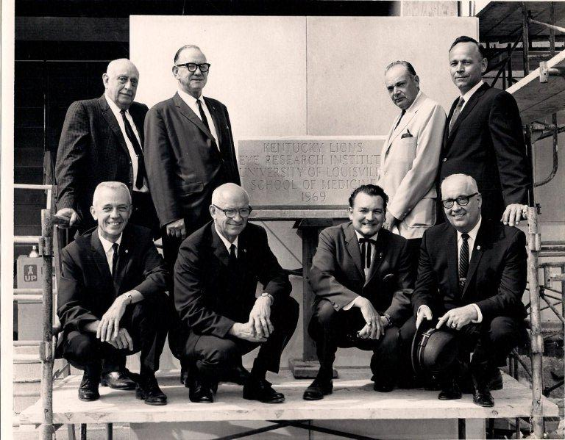
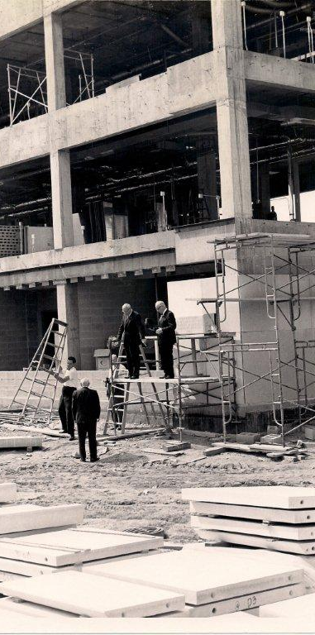
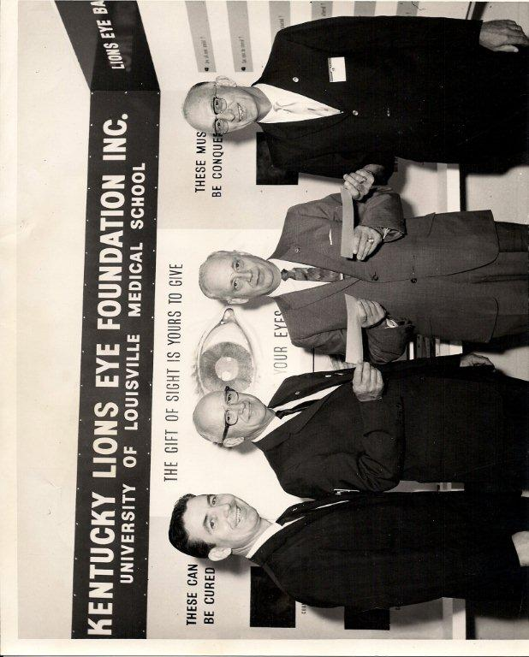
1968 The building called the Kentucky Lions Eye Research Institute was completed by the Lions at a cost of $2.2 million. Eye research along with eye care and the eye bank were all housed together at that time.
1959 Lions of Kentucky adopted the Foundation as a State Project. The Lions of Kentucky have generously given to make this Foundation a major Lions Foundation in the Country.
1958 The Eye Bank was created at the University of Louisville, a charter member of the Eye Bank Association of America.
1956 The early eye clinic was created at Louisville General Hospital, now University
Hospital in Louisville. This clinic is still in existence in the Kentucky Lions Eye Center.
1954 KLEF was incorporated.
Page 11

Slide 12
By-Laws of the Kentucky Lions Eye Foundation, Inc.
ARTICLE I
CORPORATE NAME; OFFICES
The name of the corporation is the Kentucky Lions Eye Foundation, Inc. (the “Foundation”). The Foundation’s principal office is located at 301 E. Muhammad Ali Blvd., Louisville, Kentucky 40202. The Foundation may have such other offices, either within or without the Commonwealth of Kentucky, as the business of the Foundation may require from time to time.
ARTICLE II
PURPOSE
The Foundation is organized exclusively as a public charity for charitable purposes, as described in Section 501(c)(3) of the Internal Revenue Code. The specific purposes of the Foundation shall be to solicit, collect and otherwise raise money for charitable purposes, and to expand, contribute, disburse and otherwise handle and dispose of the same for such purposes relating to the aims and goals of the Foundation and the International Association of Lions Clubs, a Section 501(c)(3) organization.
ARTICLE III
MEMBERS
The membership of the Foundation shall consist of those members in good standing with any qualifying Lions Club within Kentucky Multiple District 43, Inc. There shall be no dues payable to the Foundation by such members. The members shall only have such voting and other rights as are expressly provided for in these Bylaws. Members shall have such inspection rights, under KRS 273.233, as shall be established from time to time by the Board of Trustees.
ARTICLE IV
TRUSTEES
SECTION 1. GENERAL POWERS. The business and affairs of the Foundation shall be managed under the direction of its Board of Trustees.
SECTION 2. NUMBER, TENURE AND QUALIFICATIONS. The Board of Trustees shall consist of the following individuals:
    The following seven (7) officers of the Foundation, elected as set forth in Article V: the President, First Vice President, Second Vice President, Third Vice President, Secretary, Treasurer and Immediate Past President;
    The following nine (9) Council Trustees, including the Multiple District 43 Council Chairperson, the District 43K District Governor and its three (3) Vice District Governors, and the District 43Y District Governor and its three (3) Vice District Governors;
    Sixteen (16) District Trustees, elected as set forth below in Section 3 of this Article IV, including two (2) active members from each Region within each District of MD43;
    Three (3) Founders Trustees from the Louisville Downtown Lions Club appointed by the Club President and approved by the Club’s Board of Directors;
    All present Directors and Officers of Lions Clubs International from MD43;
    Upon his or her affirmative request, which must be renewed annually, each former Director or Officer of Lions Clubs International from MD43; and
    Upon his or her affirmative request, which must be renewed annually, each Past President.
Page 12

Slide 13
By-Laws of the Kentucky Lions Eye Foundation, Inc.
    To serve as trustee, each individual must be a member of the Foundation as set forth in Article III of these Bylaws.
SECTION 3. ELECTION AND TERM OF DISTRICT TRUSTEES.
District Trustees shall be elected from each Region of each District within MD43 as set forth in Section 2(c) of this Article IV. Such District Trustees shall be elected by their District during its Annual Meeting in accordance with procedures approved by the District.
Each such District Trustee shall be elected to serve a two (2) year term, and terms shall be staggered so that only one (1) District Trustee per Region in each District of MD43 is elected each year.
Each candidate for District Trustee shall submit documentation demonstrating he/she has the support of their Lions Club and meet the requirements of Article III. The required documentation shall be submitted to the President and/or Secretary, or their designee, on a form provided by the Foundation. Once the time for submission of endorsements and documentation has elapsed, the Foundation shall provide a list of qualified candidates to the Nominating Committee for consideration no less than thirty (30) days prior to the District Convention of each respective District of MD43. In the event there are no endorsed candidates for District Trustee in a particular Region, the respective District Governor shall identify and recommend a qualified candidate within the District to the Board of Trustees for appointment to serve the required term as the Region’s District Trustee.
SECTION 4. TERM OF OFFICE.
Officers. The term of any officer shall coincide with the term set forth in Section 2 of Article V.
Council Trustees. An individual serving as a Council trustee shall serve so long as he or she occupies the office designated in Section 2(b) of this Article IV.
District Trustees. The term of District Trustees shall be as set out in Section 3(b) of this Article IV.
Founders Trustees shall serve for a term of three (3) years and any Founder Trustee may succeed himself or herself so long as he or she is reappointed as set out in Article IV, Section 2(d).
Past and Present Directors and Officers of Lions Club International from MD43 shall serve for one-year terms, renewable annually as provided in Article IV, Section 2(f) for up to ten (10) years after such individual ceases to be a Director or Officer of Lions Club International. Notwithstanding the foregoing and applicable only for eligible Trustees as of July 1, 2019, any Trustee who is a Trustee by virtue of Article IV, Section 2(f), the ten-year term limit shall begin on July 1, 2019.
Past Presidents shall serve for one-year terms, renewable annually as provided in Article IV, Section 2(g), for up to five (5) years after such individual ceases to be the Immediate Past President. Notwithstanding the foregoing and applicable only in for Trustees as of July 1, 2019, the five-year term limit shall begin on July 1, 2019 for “active” Past Presidents. To be considered “active,” a Trustee must commit to attend seventy-five percent (75%) of the Board of Trustees meetings each year and serve on at least one Foundation committee as assigned by the Foundation President and must fulfil that commitment each year.
Page 13

Slide 14
By-Laws of the Kentucky Lions Eye Foundation, Inc.
Trustees shall serve until the earlier of [i] if the trustee is serving for a defined term, the expiration of his or her term, or if later, at such time as his or her successor is elected and qualified for office; [ii] if serving in an ex officio position, if such individual ceases to occupy the office giving rise to his or her status as a trustee; [iii] his or her resignation as trustee by written notice to the Foundation; [iv] his or her death or permanent disability and as a result of such disability he or she is no longer able to perform his or her duties as trustee; or [v] his or her removal by the Board of Trustees, as provided below.
SECTION 5. RESIGNATION. Any member of the Board of Trustees may resign as trustee at any time by giving written notice to the Foundation.
SECTION 6. REMOVAL. Any member of the Board of Trustees may be removed [i] for any or no reason by the affirmative vote of two-thirds of the trustees then in office, or [ii] for Cause, as defined below, by the affirmative vote of the majority of the trustees then in office. For purposes of this Article IV, “Cause'' shall include, but not be limited to: [a] any act of personal dishonesty taken by the trustee in connection with his or her responsibilities as a trustee which causes injury to the Foundation, [b] the trustee's conviction of a felony or of any crime that causes injury to the Foundation, [c] the trustee's failure to follow the policies and procedures adopted by the Board of Trustees, [d] violation of the trustee's fiduciary duty, or [e] excessive absences from meetings of the Board of Trustees.
SECTION 7. ANNUAL MEETING. The Foundation’s annual meeting shall be held during the MD43 Annual Convention at which the status and state of the Foundation shall be given by the President and the Executive Director. At the annual meeting, the Board shall elect trustees and officers of the Foundation, and address any other business as may properly come before the Board.
SECTION 8. QUARTERLY MEETINGS. Regular meetings of the Board of Trustees (inclusive of the annual meeting) shall be held quarterly, at such times and at such locations as the Board may from time to time designate, for the purpose of transacting any business as may come before the meeting. Annual reports, budgets and plans shall be addressed at a regular meeting at least once a year.
SECTION 9. SPECIAL MEETINGS. Special meetings of the Board of Trustees may be called by or at the request of the President, First Vice President, Secretary, or by any five (5) trustees of the Foundation. Such meeting shall be held at the principal corporate office of the Foundation or, if different, at the place, within the Commonwealth of Kentucky, designated by the person or person calling the special meeting.
Page 14

Slide 15
By-Laws of the Kentucky Lions Eye Foundation, Inc.
SECTION 10.NOTICE. Notice of any regular meeting (including the annual meeting) shall be in writing and delivered at least thirty (30) days prior to the meeting in question. Notice of any special meeting shall be in writing and delivered at least five (5) business days prior to the meeting in question. For such purposes, delivery may be by personal delivery, by U.S. mail (in which case such notice shall be deemed delivered when deposited in the United States mail in a sealed envelope properly addressed, with first class postage thereon prepaid), by email (with deemed delivery when actually sent by email to the proper address) or by facsimile transmission (with deemed delivery when actually sent by facsimile transmission to the proper address). Any trustee may waive notice of any meeting. The attendance of a trustee at any meeting shall constitute a waiver of notice of such meeting, except where a trustee attends a meeting for the express purpose of objecting to the transaction of any business because the meeting is not lawfully called or convened. Any notice required hereunder shall state the time and place of the meeting. Except as provided in Article X of these Bylaws, neither the business to be transacted at, nor the purpose of any annual, regular, or special meeting of the Board of Trustees, need be specified in the notice or waiver of notice of such meeting.
SECTION 11. QUORUM. A majority of the voting members of the Board of Trustees shall constitute a quorum for the transaction of business at any meeting of the Board of Trustees, provided that if less than a majority of the trustees are present at said meeting, a majority of the trustees present may adjourn the meeting from time to time without further notice.
SECTION 12. MANNER OF ACTING. Except as otherwise provided in these Bylaws, the act of the majority of the trustees present at a meeting at which a quorum is present shall constitute the act of the Board of Trustees.
SECTION 13. CHAIRPERSON OF THE BOARD OF TRUSTEES. The President shall serve as chairperson of the board and shall preside at all meetings of the Board of Trustees. In his or her absence, the President or the Board of Trustees may appoint one of the Vice Presidents to preside at such meetings.
SECTION 14. VACANCIES. Any vacancy occurring on the Board of Trustees shall be filled upon the vote of a majority of the remaining members of the Board of Trustees in office.
SECTION 15. COMPENSATION. No trustee shall receive compensation for his or her services as trustee; however, any reasonable expenses incurred by any trustee by reason of his or her duties or responsibilities as such may be paid by the Foundation.
SECTION 16. INFORMAL ACTION. Any action required by law to be taken at a meeting of the Board of Trustees, or any action which may be taken at a meeting of the Board of Trustees or of a committee thereof, may be taken without a meeting if a consent, in writing, setting forth the action so taken shall be signed by all of the trustees, or by all of the members of the committee, as the case may be. Such consent shall have the same effect as a unanimous vote.
Page 15

Slide 16
By-Laws of the Kentucky Lions Eye Foundation, Inc.
SECTION 17. REMOTE PARTICIPATION IN MEETINGS. Trustees may participate in and act at any meeting of the Board of Trustees through the use of a conference telephone or other communications equipment by means of which all persons participating in the meeting can hear each other. Participation in such meeting shall constitute attendance and presence in person at the meeting of the trustee so participating.
SECTION 18. ROBERTS RULES OF ORDER. Board of Trustee and committee meetings shall be governed by Roberts Rules of Order to the extent not inconsistent with the Articles of Incorporation, these Bylaws or applicable law.
ARTICLE V
OFFICERS
SECTION 1. CLASSES. The Foundation shall have the following board officers: President, three (3) Vice Presidents, Secretary, and Treasurer, and the following corporate officer: Executive Director, and may have such other officers with such duties as the Board of Trustees may determine. All such officers shall be elected in accordance with the provisions of this Article V. Any two board offices may be held by the same individual with the exception of the President and a Vice President. No officer and/or member of the MD43 Council of Governors shall be eligible to serve as an officer of the Foundation during the same time that they are serving as an officer or member of the MD 43 Council of Governors.
SECTION 2. ELECTION AND TERM OF OFFICE. The Nominations and Development Committee shall identify a qualified candidate for each office and submit the nominations in accordance with the schedule for electing officers as outlined in the Policies and Procedures Manual. Each officer shall take office on the first day of July of each year and service for a term of one year or until his or her successor is elected and takes office.
SECTION 3. REMOVAL. All officers shall be elected and may be removed, with or without cause, by a majority vote of the Board of Trustees in office. Removal as an officer shall also result in removal from the Board of Trustees.
SECTION 4. VACANCIES. A vacancy in any officer position may be filled at any special or regular meeting of the Board of Trustees. In the event of a vacancy in any office other than that of President, such vacancy shall be filled temporarily by appointment by the President until such time as the Board of Trustees shall fill the vacancy. Vacancies occurring in offices of officers appointed at the discretion of the Board of Trustees may be filled as the Board of Trustees shall determine.
SECTION 5. PRESIDENT. The President shall perform all duties incident to the office of President and such other duties in that capacity as may be prescribed by the Board of Trustees from time to time.
SECTION 6. VICE PRESIDENTS. The Vice Presidents shall perform all duties incident to the office of Vice President and such other duties in that capacity as may be prescribed by the President or the Board of Trustees from time to time. In the President’s absence, by rank, the Vice Presidents shall perform the duties of the President.
Page 16

Slide 17
By-Laws of the Kentucky Lions Eye Foundation, Inc.
SECTION 7. SECRETARY. The Secretary shall [a] keep or cause to be kept the minutes of the Board of Trustees meetings in one or more books provided for that purpose; [b] either directly or by delegation, see that all notices are duly given in accordance with the provisions of these Bylaws or as required by law; [c] ensure that the Foundation maintains its corporate records; and [d] in general, perform all duties incident to the office of Secretary and such other duties as from time to time may be assigned to him or her by the Board of Trustees. The Secretary may be assisted by an Assistant Secretary, who may be an employee of the Foundation.
SECTION 8. TREASURER. The Treasurer shall provide oversight regarding the financial affairs of the Foundation and submit periodic and annual financial reports to the Board at each Board meeting. The Treasurer shall serve as Chair of the Budget and Finance Committee, shall oversee development and execution of financial plans to manage the resources of the Foundation, including the maintenance of full and accurate accounts of the finances of the Foundation in books and records, and shall serve as the Board’s primary contact for the Foundation’s annual audit. The Treasurer shall, in general, perform, all duties incident to the office of Treasurer and such other duties as may be assigned from time to time by the President or by the Board of the Trustees. The Treasurer may be assisted by an Assistant Treasurer, who may be an employee of the Foundation.
SECTION 9. EXECUTIVE DIRECTOR. The Executive Director will direct and oversee all ongoing operations and activities of the Foundation, and will report to the Board of Trustees. In addition, the Executive Director will supervise and oversee the strategic and operational business affairs of the Foundation and will [a] prepare an annual budget for approval by the Board of Trustees; [b] prepare, develop and recommend policies, procedures and guidelines for the Foundation; and [c] oversee the Foundation's personnel, and establish and carry out personnel policies as approved by the Board of Trustees. In addition, the Executive Director shall perform such other duties as from time to time assigned to him or her by the President or by the Board of Trustees.
ARTICLE VI
COMMITTEES
SECTION 1. COMMITTEES GENERALLY. The Foundation shall have eight (8) standing committees, which shall be the Executive Committee, the Budget and Finance Committee, the Audit Committee, the Governance Committee, the Nominations and Development Committee, the Revenue and Fundraising Committee, the Service and Collaborations Committee and the Long-Range Advisory Committee.
SECTION 2. THE EXECUTIVE COMMITTEE. The Executive Committee shall consist of the officers of the Foundation, all current District Governor Trustees, and the Immediate Past President. Except as provided by law or these Bylaws, the Executive Committee shall have and may exercise such powers as may be delegated to it by the Board of Trustees. All actions taken by the Executive Committee shall be promptly reported to the Board of Trustees. The Executive Committee shall meet at such times as shall be determined by the President, who shall serve as its chair. The Executive Committee shall keep regular minutes of its proceedings and report the same to the Board of Trustees no later than the next regular meeting of the board.
Page 17

Slide 18
By-Laws of the Kentucky Lions Eye Foundation, Inc.
SECTION 3. THE BUDGET AND FINANCE COMMITTEE. The purpose of the Budget and Finance Committee is to oversee the accounting and financial reporting processes of the Foundation, review the budget and financial statements of the Foundation, oversee the Foundation’s investments in accordance with the investment policy, and make recommendations to the Board of Trustees with regard to financial matters and policies. The chair of the Budget and Finance Committee shall be the Treasurer. Meetings of the Budget and Finance Committee may be called by the Treasurer or the President.
SECTION 4. THE AUDIT COMMITTEE. The Audit Committee shall oversee the annual audit of the Foundation and the chair of that committee shall, in conjunction with the outside auditor, present the annual audit at a regular meeting for approval by the Board of Trustees.
SECTION 5. THE GOVERNANCE COMMITTEE. The Governance Committee shall be responsible for periodic review of the Bylaws, policies and procedures, and conflict of interest policies, advising the Board of Trustees on actual or potential conflict of interest matters, and such other matters as are delegated to it by the Board of Trustees or the Executive Committee. The Governance Committee shall have a subcommittee, called the Liaison Sub-Committee, which shall serve as a vehicle for communicating with the University of Louisville to address issues of common interest, to explore opportunities for collaboration. The Liaison Sub-Committee shall consist of three (3) members, at least two of whom shall be members of the Governance Committee.
SECTION 6. THE NOMINATIONS AND DEVELOPMENT COMMITTEE. The Nominations and Development Committee shall help to identify, recruit and retain qualified Foundation officers, trustees and committee members, while also assisting in the planning, development and implementation of appropriate orientation, education and training for trustees, officers and committee members. In carrying out this function, the Nominations and Development Committee shall consider such factors as (1) diversity of business, professional, and industry experience, background and specialized skills, (2) diversity of race, ethnicity and gender, (3) diversity of age, education and socioeconomic status, (4) demonstrated community leadership and involvement, and (5) potential conflicts of interest. The Nominations and Development Committee shall also establish and review criteria and procedures, subject to ultimate approval of the Board of Trustees, whereby the performance and ethical standards of Foundation officers, trustees and committee members may be measured and managed. If requested by the Board of Trustees, it shall submit a slate of candidates for Foundation officers, trustees and committee members for election to office.
SECTION 7. THE REVENUE AND FUNDRAISING COMMITTEE. The Revenue and Fundraising Committee shall assist the Executive Director with creation and implementation of the Foundation’s financial resource plan and strategies to acquire adequate funding. Excepting investment oversight, the Revenue and Fundraising Committee shall oversee and seek to enhance and expand all revenue generating and fundraising activities, programs and initiatives of the Foundation, including trustee support, individual donations and corporate giving; annual fund and long-term capital campaigns, fundraising events; estate planning development; and grant applications.
Page 18

Slide 19
By-Laws of the Kentucky Lions Eye Foundation, Inc.
SECTION 8. THE SERVICE AND COLLABORATIONS COMMITTEE. The Service and Collaborations Committee shall assist the Executive Director in seeking to maintain the Foundation’s reputation for excellence throughout the Commonwealth of Kentucky as a provider of diverse vision services, of information and of referrals in meeting its mission statement of enabling greater independence and increased quality of life through vision education, detection, prevention, treatment and empowerment services, programs and initiatives. The Service and Collaborations Committee shall have a subcommittee called The Holloran Trust Sub-Committee, which in conjunction with The Holloran Trust Advisory Committee shall be responsible for overseeing the Foundation’s administration of The Holloran Trust in pursuit of its charitable mission. The Holloran Trust Sub-Committee shall consist of three (3) Founders Trustees from the Louisville Downtown Lions Club. The Service and Collaborations Committee shall have a subcommittee called The Patron Sub-Committee, which shall be responsible for overseeing the Foundation’s administration of The Patron Trust Fund in pursuit of its charitable mission.
SECTION 9. THE LONG-RANGE ADVISORY COMMITTEE. The Long-Range Advisory Committee shall provide the Foundation advice, guidance, assistance, and leadership, as requested by the President, Executive Committee, and/or Board, particularly in regard to the Executive Director’s development and annual updating of the Foundation’s long-range plan to ensure continued relevance, effectiveness, financial stability, and growth of services.
SECTION 10. COMMITTEE APPOINTMENT AND SIZE. Excepting the Executive Committee and advisory committees, each committee shall consist of from three (3) to eight (8) members, with its members appointed by the Board of Trustees or, if so delegated by the Board of Trustees, by the President. With the exception of the Executive Committee and the Budget and Finance Committee, the chair of each committee shall be appointed by the Board of Trustees or, if so delegated by the Board of Trustees, by the President.
SECTION 11. COMMITTEE MEETINGS. Except as otherwise provided, meetings of committees (including each subcommittee) shall be held at such times and places as shall be fixed by the President, by the respective committee chair, or by vote of a majority of all of the members of the committee. Written notice shall be given to all members of the committee not less than three (3) days before each meeting. Written minutes of the proceedings shall be kept at all committee meetings and, after approval by the committee, shall be submitted at the next meeting of the Board of Trustees. Any committee member may waive notice of any meeting. The attendance of a committee member at any meeting shall constitute a waiver of notice of such meeting, except where a committee member attends a meeting for the express purpose of objecting to the transaction of any business because the meeting is not lawfully called or convened.
SECTION 12. QUORUM AND MANNER OF ACTING. Unless otherwise provided by resolution of the Board of Trustees, a majority of all of the members of a committee (including each subcommittee) shall constitute a quorum and the act of a majority of the members present at a meeting at which a quorum is present shall be the act of the committee. With the exception of the Executive Committee, which shall consist only of board members, any other board committee may have non-board members on the committee so long as (a) the board members on such committee outnumber the non-board members, and (b) committee action shall require the affirmative vote of a majority of board members on such committee.
Page 19

Slide 20
By-Laws of the Kentucky Lions Eye Foundation, Inc.
SECTION 13. TERM OF OFFICE. Each committee and subcommittee member shall serve until the next annual Board of Trustee meeting or, if later, until his or her successor is appointed, unless the committee shall be sooner terminated, or unless such member is removed from such committee, or unless such member shall cease to qualify as a member thereof.
SECTION 14. ADVISORY COMMITTEES. The Foundation may have such advisory committees as it deems in its best interest. Any such committee shall be advisory only and shall have no authority to bind the Foundation legally or to authorize the payment of monies or the incurrence of debt or expenditures of the Foundation. Members of advisory committees need not be members of the Board of Trustees. Any such committee shall be established and members appointed thereto in such manner as is established by the Board of Trustees.
SECTION 15. POLICIES AND PROCEDURES MANUAL. So long as they are not inconsistent with the Corporation’s Articles of Incorporate or these Bylaws, the duties of each committee and subcommittee may be further described in the Foundation’s Policies and Procedures Manual, as approved by the Board of Trustees.
ARTICLE VII
CONTRACTS, LOANS, CHECKS AND DEPOSITS
SECTION 1. CONTRACTS. The Board of Trustees may authorize any officer or officers, including any board officer, to enter into any contract or execute and deliver any instruments in the name of and on behalf of the Foundation, and such authority may be general or confined to specific instances.
SECTION 2. LOANS. No loan shall be contracted on behalf of the Foundation, and no evidence of indebtedness shall be issued in its name unless authorized by a resolution of the Board of Trustees. Such authority may be general or confined to specific instances.
SECTION 3. CHECKS, DRAFTS, ORDERS, ETC. All checks, drafts, or other orders for payment of money, notes or other evidences of indebtedness issued in the name of the Foundation shall be signed by such officer or officers, including any board officer, of the Foundation and in such manner as shall from time to time be determined by resolution of the Board of Trustees or as provided in these Bylaws.
SECTION 4. DEPOSITS AND INVESTMENTS. All funds of the Foundation not otherwise utilized shall be deposited from time to time to the credit of the Foundation in such banks, trust companies, or other depositories as the Board of Trustees may select, and such funds shall be invested in accordance with policies adopted by the Board of Trustees.
Page 20

Slide 21
By-Laws of the Kentucky Lions Eye Foundation, Inc.
ARTICLE VIII
CORPORATE RECORDS AND REPORTS
The Foundation shall maintain the following records at its principal office:
Minutes of all meetings of the Board of Trustees, the Executive Committee and committees of the Board of Trustees, together with all other meetings of members of the Foundation indicating the time and place of holding such meetings, whether regular or special, how called, the notice given, and the names of those present and the proceedings thereof;
Adequate and correct books and records of account, including accounts of its properties and business transactions and accounts, assets, liabilities, receipts, disbursements, and gains and losses; and
A copy of the Foundation’s Articles of Incorporation and Bylaws.
ARTICLE IX
WAIVER OF NOTICE
Whenever any notice whatsoever is required to be given under the provision of these Bylaws, or under the provisions of the Articles of Incorporation, or under the provisions of the Corporation laws of the Commonwealth of Kentucky, waiver thereof in writing, signed by the person, or persons, entitled to such notice, whether before or after the time stated therein, shall be deemed equivalent to the giving of such notice.
ARTICLE X
AMENDMENT OF BYLAWS
These Bylaws may be amended, altered, changed, added to or repealed by the affirmative vote of a two-thirds of the Board of Trustees if notice of the proposed amendment, alteration, change, addition or repeal be contained in the notice of the meeting to the Board of Trustees.
These Bylaws were amended by vote of the Trustees at their regular meeting held on May 20, 2023, with the effective date July 1, 2023.
_________________________________________
President, Board of Trustees
_________________________________________
Secretary
61812501.7
Page 21

Slide 22
KLEF Conflict of Interest Policy
Article I – Purpose
The purpose of this policy is to protect the tax-exempt status of the Kentucky Lions Eye Foundation when it is contemplating entering into a transaction or arrangement that might benefit the private interest of an officer or trustee of the Kentucky Lions Eye Foundation (KLEF) or might result in a possible excess benefit transaction. This policy is intended to supplement but not replace any applicable state or federal laws governing conflict of interests applicable to nonprofit or charitable organizations.
Article II – Definitions
1. Interested Person – Any trustee, principal officer, or member of a committee with trustee delegated powers, who has a direct or indirect financial interest, as defined herein, is an interested person.
2. Financial Interest – A person has a financial interest if the person has, directly or indirectly, through business, investment, or family has:
a) An ownership or investment in any entity with which the KLEF has a transaction or arrangement.
b) A compensation arrangement with KLEF or any entity or individual with which KLEF has a transaction or arrangement.
c) A potential ownership or investment interest in, or compensation arrangement with, any entity or individual with which KLEF is negotiating a transaction or arrangement.
3. Compensation includes direct or indirect remuneration as well as gifts or favors that are not insubstantial.
4. A financial interest is not necessarily a conflict of interest. Under Article III, Section 3, a person who has a financial interest may have a conflict only if KLEF Executive Committee decides that a conflict of interest exists.
Article III – Procedures
1. Duty to Disclose – In connection with any action or possible conflict of interest, an interested person must disclose the existence of the financial interest and be given the opportunity to disclose all material facts to the Executive Committee which has Board of Trustees approval to consider the proposed transaction or arrangement.
2. Determining Whether a Conflict of Interest Exists. After disclosure of the financial interest and all material facts, and after any discussion with the interested person, he or she shall leave the Executive Committee meeting while the determination of a conflict of interest is discussed and voted upon. The remaining Executive Committee members shall decide if a conflict of interest exists by majority vote.
Page 22

Slide 23
KLEF Conflict of Interest Policy
3. Procedures for Addressing the Conflict of Interest
a) An interested person may make a presentation to the Executive Committee but after the presentation he or she shall leave the meeting during the discussion of, and the vote on, the transaction or arrangement involving the possible conflict of interest.
b) The chairperson of the Executive Committee shall if appropriate appoint a disinterested person or committee to investigate alternatives to the proposed transaction or arrangement so as to avoid a conflict of interest.
c) After exercising due diligence, the Executive Committee shall determine whether KLEF can obtain with reasonable efforts a more reasonable advantageous transaction or arrangement from a person or entity that would not give rise to a conflict of interest.
d) If a more advantageous transaction or arrangement is not reasonably possible under circumstances not producing a conflict of interest, the Executive Committee shall determine by a majority vote of the disinterested members whether the transaction or arrangement is in KLEF’s best interest, for its own benefit, and whether it is fair or reasonable. In conformity with the above determination the Executive Committee shall make its decision as to whether to enter into the transaction arrangement.
2. Violations of the Conflict of Interest Policy
a) If the Executive Committee has reasonable cause to believe a member has failed to disclose actual or possible conflicts of interest, it shall inform the member of the basis for such belief and afford the member an opportunity to explain the alleged failure to disclose.
b) If, after hearing the member’s response and making further investigation as warranted by the circumstance, the Executive Committee determines the member has failed to disclose an actual or possible conflict of interest, it shall take appropriate disciplinary and corrective action.
Article IV – Records of Proceedings
1. The Minutes of the Executive Committee shall contain:
a) The names of the persons, who disclosed or otherwise were found to have a financial interest in connection with an actual or possible conflict of interest, the nature of the financial interest, any action taken to determine whether a conflict of interest was present and the Executive Committee’s decision as to whether a conflict of interest fact existed.
b) The names of the persons who were present for the discussion and votes relating to the transaction or arrangements, the content of discussion, including any alternatives to the proposed transaction or arrangement, and a record of any votes taken in connection with the proceedings.
Page 23

Slide 24
KLEF Conflict of Interest Policy
Article V – Compensation
1. KLEF does not compensate any member of the Executive Committee, except for reimbursement for minor expenses incurred by the member which must be duly authorized by a majority of the Executive Committee.
2. In the event a voting member seeks reimbursement for minor expenses incurred by that member, then that member shall not participate in a vote by the Executive Committee on the authorization of such reimbursement.
Article VI – Annual Review
At the beginning of each term of office, each trustee and all members who is a member of the Executive Committee and all officers shall review this Conflict of Interest Policy and shall sign a statement acknowledging such person has:
1. Received a copy of the conflicts of interest policy (or acknowledge he or she was provided an opportunity to obtain a copy of said policy and thereby waived obtaining a copy)
2. Has read and understands the policy
3. Has agreed to comply with the policy
4. Understands that KLEF is a charitable foundation and in order to maintain its Federal Tax Exemption it must engage primarily in activities which accomplish one or more of its tax-exempt purposes.
To ensure KLEF operates in a manner consistent with charitable purposes and does not engage in activities that could jeopardize its tax-exempt status, the Board of Trustees will review this policy on an annual basis to verify it is in compliance with the charitable purposes of the KLEF.
Said review shall include:
1. Whether any compensation for minor expenses are reasonable and the result of arm’s length bargaining.
2. Whether the authorization for payment of such minor expenses is reflected in the minutes of the Executive Committee records after being properly voted on by the Executive Committee.
In conducting this annual review the Board of Trustees may, but not need, use outside advisors. If outside experts or advisors are used, their use shall not relieve the Board of Trustees of its responsibility to ensure compliance with the charitable purposes for which KLEF was created and compliance with laws under which KLEF operates. In the event the Board of Trustees deems it necessary, this policy may be modified pursuant to the Bylaws of KLEF.
Page 24

Slide 25
KLEF Conflict of Interest Policy
Kentucky Lions Eye Foundation
Conflict of Interest Policy
Compliance Statement
Pursuant to the Article I1 of the Kentucky Lions Eye Foundation’s Conflict of Interest Policy
I, the undersigned, ______________________________ (Please Print Name), being a KLEF Trustee member and/or the charitable foundation’s Executive Committee member, do now and hereby sign this statement acknowledging, as follows:
1) I have received and reviewed during the current fiscal year a copy of the charitable foundation’s Conflict of Interest Policy (or acknowledge I was provided an opportunity to obtain a copy of said policy, but waived receiving the same).
2) I read and understand the policy.
3) I agree to comply with the policy.
4) I understand KLEF is a charitable foundation and in order to maintain its Federal Tax Exemption status it must engage primarily in activities which accomplish one or more of its tax-exempt purposes.
IN TESTIMONY WHEREOF, I the undersigned have affixed my signature on the ____ day of _______________, 2025.
______________________________
(Signature)
AS WITNESSED BY:
Print Name: _______________________________
Signature: ________________________________
Page 25

Slide 26
KLEF Corporate Structure
KLEF, Inc.
Lions - Members
Elected Trustees/Officers
MD-43 Governors
International Directors
Past KLEF Presidents
Staff
Sources of Revenue
Restricted Funds
Trusts – income unrestricted
Bequests, Memorials, Planned Giving
Candy Days
Fundraising Events
Grants
Donations
Patron Trust
Holloran Trust
Service Endowment
Programs/Services
Programs/Services
Holloran
Patron
Vision Van
KidSight
Low Vision Clinic
Collaborations
MD – 43
Univ. of Lou. DOVS
KY Head Start Association
Page 26

Slide 27
KLEF Committee Structure
PRESIDENT
Executive Committee
1st Vice
President
3rd Vice
President
2nd Vice
President
Audit Committee
Budget and Finance / Investments Committee
Long-Range Advisory Committee
Governance Committee
Nominations and Development Committee
Service and Collaborations Committee
Revenue and Fundraising Committee
Page 27

Slide 28




KLEF Fundraising / Development
KLEF Annual Fundraisers
Mr. and Miss Kentucky Basketball Awards Ceremony
Each year at the end of basketball season, KLEF announces the top high school basketball players in the state and celebrates their accomplishments at this annual Awards Ceremony event. Anyone can purchase tickets, and all funds raised go to support the KLEF general fund.
KLEF has announced Mr. Kentucky Basketball since 1954.
KLEF has announced Miss Kentucky Basketball since 1976.
For more information, please visit www.kylionseye.org
Kentucky Gives Day
Each Spring, Kentucky Gives Day is an opportunity for Kentuckians to come together to make donations to Kentucky charities in an effort to raise as much money as possible in 24 hours. Donations can be made by individuals, Clubs, and businesses. Matching gift donations are also accepted to maximize the success.
Donations accepted on Kentucky Gives Day support KLEF general fund.
For more information, please visit www.kygives.org.
Give for Good Louisville
Each Fall, the Community Foundation of Louisville's Give For Good Louisville provides residents and
non-residents with this unique opportunity to support and give back to nonprofits based in Louisville, KY. During this 24-hour online giving day there are 500+ participating nonprofits that make our community a great place to live, work, and play. Donations can be made by individuals, Clubs, and businesses. Matching gift donations are also accepted to maximize the success.
For more information, please visit www.giveforgoodlouisville.org
Drive 4 Sight Golf Scramble
Each October, KLEF hosts the Drive 4 Sight Golf Scramble, which is a fun day
for Lions and non-Lions to compete on the course and help raise money to support the KLEF general fund.
Sponsorship opportunities are available, as well as individual & team registrations.
For more information, please visit www.kylionseye.org
Page 28

Slide 29



KLEF Fundraising / Development
Easy Ways for Anyone to Support KLEF Year-round
Cooking for the Cause Cookbook
In 2021 KLEF published our first cookbook, “Cooking for the Cause”.
Copies are available for anyone to purchase.
Discounts are available for Clubs or individuals who want to purchase 25+ copies.
Visit www.kylionseye.org/cookbook to order or to learn more.
GiveBHG
Visit GiveBHG.com in order to purchase BHG gift cards.
Select a BHG gift card of any denomination.
Select Kentucky Lions Eye Foundation as your chosen charity.
Your gift card will be sent in the mail or electronically and KLEF will receive 20% of your purchase amount as a donation.
BHG gift cards can be used at any of the Bluegrass Hospitality concepts, including 19 different locations of Drake's, Malone's, Harry's American Bar & Grill, OBC Kitchen, and Aqua Sushi. Various locations are in Louisville, Lexington Nicholasville and Florence, KY; Knoxville, Chattanooga, Bristol and Franklin, TN; Indianapolis, IN; Huntsville, AL; and Burlington, NC.
Kroger
Go to Kroger.com and register your Kroger Plus Card.
You will need to create an account using your email address.
Select Kentucky Lions Eye Foundation under 'Community Rewards'.
The amount donated varies based on how much is spent with KLEF registered cards vs. other organizations, so spread the word to everyone you know that shops at Kroger.
Become a Friend of the Foundation and
Join our 20/20 Club!
To ensure the long-term success of the Foundation, we invite
individuals to become Friends of the Foundation by joining
our 20/20 Club.
To join, simply setup your $20 monthly tax-deductible donation to KLEF using a credit or debit card by using the form below or contact KLEF to set up a recurring electronic transfer from your checking account.
Upon joining the 20/20 Club, you will receive a token of our gratitude to welcome you. Plus, you will know that your recurring gifts are helping provide a spark of hope to those in need!
Page 29

Slide 30
KLEF Fundraising / Development
Easy Ways for Anyone to Support KLEF Year-round
Become a Friend of the Foundation and Join our 20/20 Club!
​
To become a member of the 20/20 Club, simply visit: www.kylionseye.org/2020club. Please contact KLEF staff by calling 502-583-0564 to make arrangements to join the 20/20 Club with cash or check payments.
All current 20/20 Club members are listed below (as of 6/26/2025), and they are also listed on our website; future members will be added to the website listing as they become Friends of the Foundation.
As of June 26, 2025, our amazing 20/20 Club members have collectively donated over $46,300 in support of the Kentucky Lions Eye Foundation’s mission!
Your name could be next when you become a member of the 20/20 Club!
Chuck Carlson
Lindy Lamkin
Mark Webster
Dave Satterly
Tom VanEtten**
Guy Hollander
Phyllis Carlson
John J. Johnson, III**
Cynthia Ferguson
George Lonneman
Dale Barrett
Gil Wentzel
Jeremy Prince
Mac Ferguson
Jeff Lorenzen*
Shea Nickell
Richard Rogers
Judy Wright*
Fred Wright
David Moose
Pam Elrod
Marsha Pater
Carol Dahmke**
Mark Fietsch
Gary Logan
Dr. Carolyn Watson
Carol Hollander
Ramon Buntin**
Verna Sharp
James Weise
Andrew Clay**
Gary Sensabaugh*
Shirley Moore
Andrea "Nikie" Walker**
Andrei’ Tunsil
Col. Ronald G. Forrester
Nancy Pence
Clay Diamond
Carolyn Grace
Lance Turlington
Aaron Witten
Linda Crabtree
James Williams
Randy Morris
Beth Morris
Dr. Ken Wolf
Pam Powers
* Denotes individual has passed away.
​
** Denotes individual has ended their 20/20 Club contributions.
​
Page 30

Slide 31
KLEF Fundraising / Development
Ways that Clubs can Support KLEF
Candy Days
Candy Days is a Past District Governors Association project started in 1970. Since inception this program has raised over $957,500 for the Kentucky Lions Eye Foundation.
Lions Clubs choose various locations like shopping centers, grocery stores, roadblocks, etc. and club members give away candy in return, members accept donations. Half of the proceeds go to the Lions Club’s charity account and half is sent to the Kentucky Lions Eye Foundation.
Donations
At any time, Clubs can make a donation to the KLEF general fund or to support a specific program.
Please note on the memo line of check what the donation is for and mail the check to KLEF at 301 E. Muhammad Ali Blvd., Louisville, KY 40202.
Donations can also be made online by visiting www.kylionseye.org/donate.
Give recognitions to your fellow club members or community members
Your club can name a Lion or community member a Finis Davis Fellow or Progressive Finis Davis Fellow by submitting a Finis Davis/Progressive Finis Davis application along with a donation.
  Finis Davis Fellow - $500 donation
  Progressive Finis Davis Fellow - $1,000+ donation
Your club can name a Lion or community member a Life Patron, Silver Patron or Gold Patron with a donation to the Patron Program.
  Life Patron - $100 donation
  Silver Patron - $500 donation
  Gold Patron - $1,000 donation
Memorials / Honorariums
Clubs or individuals can make donation to KLEF in memorial and / or in honor of someone.
Please include name and address of the person(s) that you want to receive notice of your donation.
KLEF sends thank you notes to the donor and to the family of the deceased (if name and address is provided).
Page 31

Slide 32
KLEF Online Resources
KLEF Website – www.kylionseye.org
About Us
Link to make online donations.
List of current Executive Board members.
Contact information for KLEF staff members.
Programs
Detailed information listed for the KLEF programs, including any paperwork, forms or applications pertaining to each program:
  KidSight
  Vision Van
  Patron Program
  Holloran Program
  Low Vision Clinic
  Louisville Lions Club Eyeglass Programs
  Ways to Recycle Glasses
Get Involved
Detailed information listed for how individuals or Clubs can get involved with KLEF, including links to upcoming events such as:
  Mr. and Miss Kentucky Basketball Awards Ceremony
  Drive 4 Sight Golf Scramble
Lions Info
Detailed information listed specifically for Lions Club members, including paperwork, applications and forms for:
  Vision Screenings at the Kentucky State Fair
  KidSight Program
  Vision Van Volunteers
  Club Survey Link (https://www.kylionseye.org/survey)
  Lions Recognition
    Finis Davis/Progressive Fellowship Application
    Life Patron
  Trustees
    Club Visitation Forms
    Trustee Application Form
    Committee Selection Form
Page 32

Slide 33

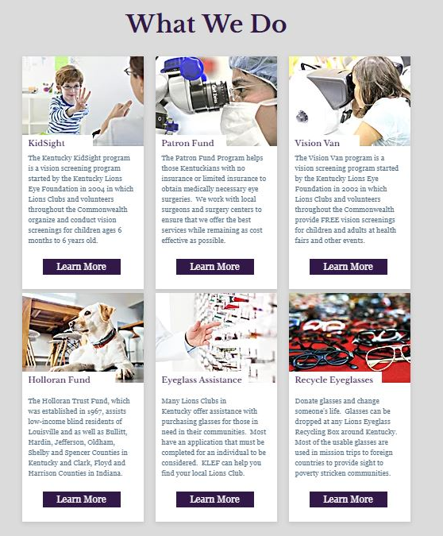

KLEF Online Resources
KLEF Website – www.kylionseye.org
News
Find the latest updates and news from KLEF at this link.
Donate
By clicking this link, individuals can donate directly to KLEF through our secure website with a debit card or credit card.
To request changes / updates / additions to the KLEF website, please contact
Jennifer Hunt Spurling. (JenniferHunt@kylionseye.org or 270-999-4887)
Page 33

Slide 34
KLEF Online Resources
KLEF Social Media - Networking
Follow, Like & Share our info:
KLEF Facebook (www.facebook.com/kylionseye)
KLEF Instagram (@kylionseye)
Mr. & Miss KY Basketball Facebook (www.facebook.com/mrandmisskybball)
Mr. & Miss KY Basketball Instagram (@Mr_MissKYBball)
Mr. & Miss KY Basketball Twitter (@Mr_MissKYBball)
KLEF sends out a monthly newsletter. To subscribe, email JenniferHunt@kylionseye.org
Importance of Social Media
Social media (websites and apps that let users create, share and network) allows organizations with even the most limited budgets to reach a broad audience in a quick, cost-effective way. These platforms allow us to tell our organization's story.
Social media messages can help engage supporters, capturing and retaining their attention. Social media can also increase awareness of KLEF, which may support fundraising efforts and mission accomplishment.
An investment in social media and social listening can play an important role in the success of our organization. We continuously consider how these platforms can improve our ability to engage with supporters and further our reach, as well as our mission.
Social Media Strategy
KLEF staff is dedicated to continue developing our social media strategy that is integrated with our overall marketing strategy and aligned with our mission, goals and target audiences. Developing and posting a variety of frequent posts and interactions will promote visibility and community engagement, leading to more collaboration opportunities and a broader network of supporters of KLEF.
Social media presents the opportunity to connect with supporters by responding to questions and comments or joining in new conversations. With a little creativity and humor, dialogue can be established that helps donors feel more connected and engaged. Social media also enables KLEF to continuously update audiences about our work, inform them about how they can get involved, and share relevant information with them to strengthen the image and reputation of KLEF.
Page 34

Slide 35
Finis E. Davis Fellowship Application
The Finis E. Davis Fellowship was created to honor the memory of Kentucky’s first and only President of Lions Clubs International. PIP Finis served as President of LCI in 1960-1961. Then in 1967-68 he was President of the Kentucky Lions Eye Foundation. He spearheaded the drive to raise the first two million dollars to build the Kentucky Lions Eye Research Institute, which is now a world-class center, and dedicated his life to Lionism. The fellowship is available to anyone and it may be given posthumously as a memorial.
The Davis Fellowship may be obtained by a contribution of $500 or more to the Kentucky Lions Eye Foundation. The contribution may be made at once or over a period of time by making payments of no less than $100. The Fellowship will be presented upon receipt of the final payment. Contributions can be made online at www.kylionseye.org/donate or by a check made payable to the Kentucky Lions Eye Foundation.
The recipient of the Finis E. Davis Fellowship will receive a personalized plaque from the current Kentucky Lions Eye Foundation President, a Finis E. Davis Fellow patch and Finis E. Davis Fellow pin.
Individuals who are already a Finis Davis Fellow can receive a Progressive Finis Davis Fellowship. For an additional contribution to the Kentucky Lions Eye Foundation, the Progressive Finis Davis Fellow would receive an exclusive Progressive Finis E. Davis Fellow pin with diamond(s) with the following contribution amounts:
PLEASE COMPLETE THE FORM BELOW TO REQUEST A FINIS E. DAVIS FELLOWSHIP:
Finis E. Davis Fellowship ($500)☐ Progressive (1 diamond)☐
Progressive (2 diamonds)☐ Progressive (3 diamonds)☐
Progressive (4 Diamonds)☐
Name of recipient: ______________________________ Email: _____________________________________
Address: ______________________________________ City: ________________ State: ____ Zip: _______
Club or Individual Presenting Fellowship ____________________________________ MD43 District _______
Send plaque, pin and patch to: _____________________________ Email: ______________________________
Address _______________________________________ City __________________ State ____ Zip _______
Date that plaque, pin and patch is needed to be presented: ______________ (Please allow 4 weeks to delivery)
Amount of check enclosed: __________ (Not less than $100)
Please print and mail this application along with payment check(s) to KLEF (301 E. Muhammad Ali Blvd., Louisville, KY 40202). You may email completed applications to KarenHayse@kylionseye.org, but please mail all checks to the KLEF office.
Please include a short bio of your recipient when you submit this application.
Page 35

Slide 36
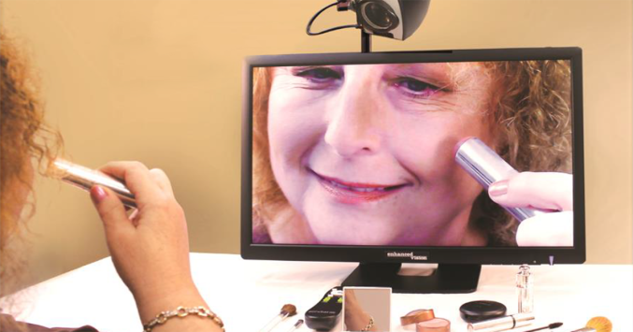
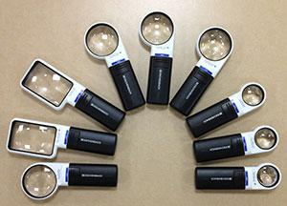

Holloran Trust
.
The Holloran Trust Fund, which was established in 1967, assists needy blind people of Louisville as well as Bullitt, Hardin, Jefferson, Oldham, Shelby and Spencer Counties in Kentucky and Clark, Floyd and Harrison Counties in Indiana. Requests for help are considered by a committee of Lions Club members who have been selected to manage the Holloran Trust Fund under the direction of the Kentucky Lions Eye Foundation. The review committee meets every other month at KLEF. The maximum amount that can be requested by/awarded to one individual is $3,000.
Verification of need and legal blindness must be provided on the application for assistance.
During the Fiscal Year 2024-2025, the Holloran Trust Program supported 50 individuals by granting a total of $8,140.48 in financial support for their needs.
Page 36

Slide 37
Holloran Trust Application
READ THIS LETTER BEFORE FILLING OUT YOUR APPLICATION.
Dear Sir or Madam:
Enclosed you will find the Holloran Trust application for assistance you requested from the Kentucky Lions Eye Foundation. Please make sure you fill the form out completely and provide the information requested.
The Holloran Trust Fund, which was established in 1967, assists needy blind people of Louisville as well as Bullitt, Hardin, Jefferson, Oldham, Shelby and Spencer Counties in Kentucky and Clark, Floyd and Harrison Counties in Indiana. Requests for help will be considered by a committee of Lions Club members who have been selected to manage the Holloran Trust Fund under the direction of the Kentucky Lions Eye Foundation. The Holloran Trust Committee meets every other month to go over any application requests. After their meeting and review of your application, you will be informed by phone or letter if your application has been approved or not.
▪You must provide verification of need and legal blindness on the application in order for your application to be considered for assistance.
▪You must provide documentation of your monthly support. If you have a place to live (other than a homeless shelter), you have support coming in every month. Please make sure you attach some kind of documentation. Some examples: food stamp letter, disability letter, or paycheck stub. PLEASE DO NOT MAIL ORIGINALS.
▪You must mail the application to the Kentucky Lions Eye Foundation at: 301 E. Muhammad Ali Blvd., Louisville, KY 40202.
Failure to do any of these things will result in a delay of processing for your application. Feel free to use this letter as a checklist to make sure you have completed all of the necessary steps.
Thank you,
Kentucky Lions Eye Foundation
Page 37

Slide 38
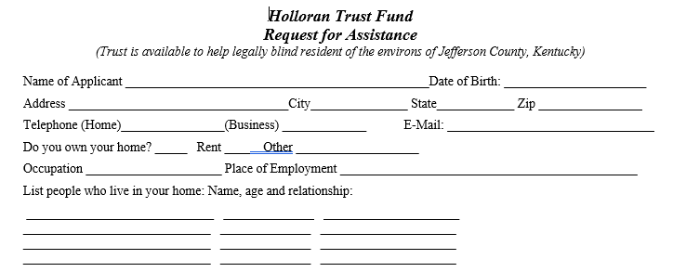
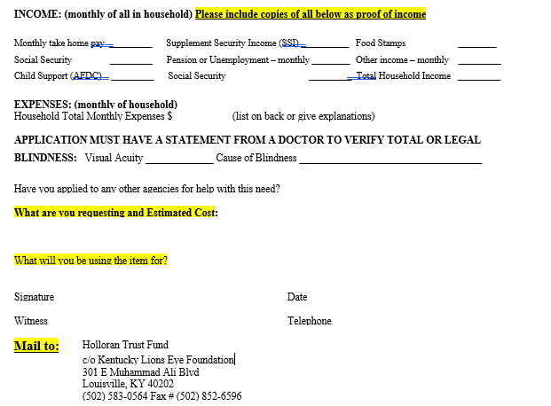
Holloran Trust
Page 38

Slide 39


KidSight Program
What is KidSight?
The Kentucky KidSight Program is a vision screening project started by the Kentucky Lions Eye Foundation in 2004. Through the KidSight Program, Lions Clubs and volunteers throughout the Commonwealth organize and conduct free vision screenings for children between the ages of 6 months to 6 years old. As of June 30, 2025, we have screened 262,423 children through the KidSight Program. KLEF reports all screenings to Lions KidSight USA.
What does a screening cost?
The screening is FREE thanks to support and volunteer efforts of Kentucky Lions Clubs and Program donors and supporters.
If your club is interested in participating in the KidSight program, please contact Lion Karen Hayse, KidSight State Coordinator (karenhayse@kylionseye.org or 1-502-583-0564). All volunteers must complete a Background Check.
Page 39

Slide 40
KidSight Volunteer Background Check Form
** PLEASE PRINT & COMPLETE **
CONFIDENTIAL
Background checks cannot be completed without all of the below information
Name: ___________________________ Date of Birth: ________________
Maiden Name(s) and/or Alias: ____________________________________________
Phone Number: ( ) ________________ Social Security #: ___________________
Mailing Address: _______________________________________________________
City, State & Zip Code: __________________________________________________
Email Address: ________________________________________________________
Lions Club (if applicable): ________________________________________________
Please complete the above form and return to:
Karen Hayse
Kentucky Lions Eye Foundation
301 East Muhammad Ali Blvd.
Louisville, KY 40202
Email: karenhayse@kylionseye.org
Background Checks will be completed by KLEF staff and will not be disclosed to anyone but the volunteer. Background Checks will be re-run for each KidSight Volunteer four years from the time that their Background Check was initially run.
Page 40

Slide 41
Kentucky KidSight
Vision Screening Cover Sheet
(children under 7-yrs of age)
A. Vision Screening Site Information (PLEASE PRINT)
1. Date: ______________________________ Day Care ___ Pre ____ K____ HeadStart _____
2. Name of Screening Site:___________________________________________________
3. Teacher: _____________________ Classroom: ____________ AM ___ PM ___
4. Address: ______________________________________________________________
5. City & Zip Code: ________________________________________________________
6. County: _______________________________________________________________
7. Contact Person: _____________________ E-mail: _____________________________
8. Phone: (___________)____________________________________________________
B. Preliminary Screening Results
Total Number of Children: ______ Pass____ Refer____ C.U.T. _____
C. Lions Club Information:
1. Lions Club Contact: ____________________________________________
2. Address: _____________________________________________________
3. City & Zip Code: ______________________________________________
4. County: ______________________________________________________
5. Lions Club: ____________________________ District: ___________
6. Telephone Number: ____________________________________________
7. Total # of hours including travel time: ______________________________
Please send the Cover Sheet, one copy of referrals and the consent form for the referrals to:
Kentucky Lions Eye Foundation, KidSight Program
301 E Muhammad Ali Blvd.
Louisville, KY 40202-1594
Phone: (502) 583-0564
Fax: (502) 852-6596
Page 41

Slide 42
Kentucky Lions Eye Foundation
KidSight Program
(children under 7-yrs of age)
Dear Parents or Guardian:
Your child’s eyes were screened recently by volunteers in our KidSight Program. The results of the screening indicated the need for a more complete eye examination by an ophthalmologist or optometrist. Because poor vision can affect learning and development, it is important for your child to be seen by an eye specialist.
Please follow the steps below:
Call an eye doctor in your area to make an appointment for your child.
Take your child to the appointment. Please take the Evaluation Form included in this packet with you to the appointment. Please request that the doctor take the time to complete this form and fax it back to the Kentucky Lions Eye Foundation at (502) 852-6596. Your feedback is important so we can measure the impact of our services. All information is kept completely confidential within our program.
If you have any questions about the screening process or results, please call Karen Hayse at the Kentucky Lions Eye Foundation at (502) 583-0564.
Page 42

Slide 43
Kentucky KidSight Evaluation Sheet
(children under 7-yrs of age)
This patient has been recommended for a complete pediatric eye exam after failing a vision screening through the KidSight Program. Please fill out the form as completely as possible and fax to the Kentucky Lions Eye Foundation at (502) 852-6596.
Child’s Name: __________________________ Date of Birth: _____________________
Date of Vision Screening: __________________ City of Screening: __________________
(To be completed by MD/OD)
Date of Exam: _________________ Name of reporting MD/OD: ___________________
Visual Acuity: OD: _­­­­_______ OS: _______
Diagnosis: (please check all that apply):
◻ Anisocoria– Slight differences in pupil sizes are found in healthy people.
◻ Anisometropia - A condition in which the two eyes have unequal refractive power.
◻ Astigmatism - condition when the cornea has an abnormal curve, causing out-of-focus vision.
◻ Hyperopia (Farsightedness) - Causes difficulty seeing objects that are near, appear blurred.
◻ Myopia (Nearsightedness) – Causes difficulty seeing distant objects, appear blurred.
◻ Strabismus - When the eyes are not directed to an object simultaneously. Sometimes the eyes deviate inward and other times the eyes deviated outward.
Treatment (please check all that apply):
  ______None ______Glasses ______ Patch ______ Surgery
  Other (Please specify): ___________________________________________________
Follow-Up: ________None ______ Other (Include date): _____________________
Thank you for participating in the Kentucky Lions Eye Foundation KidSight Program.
Page 43

Slide 44
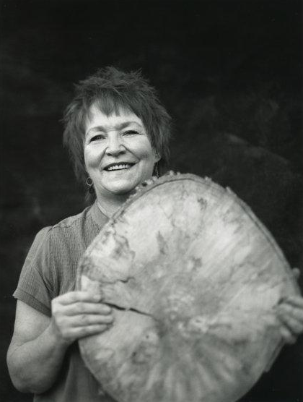
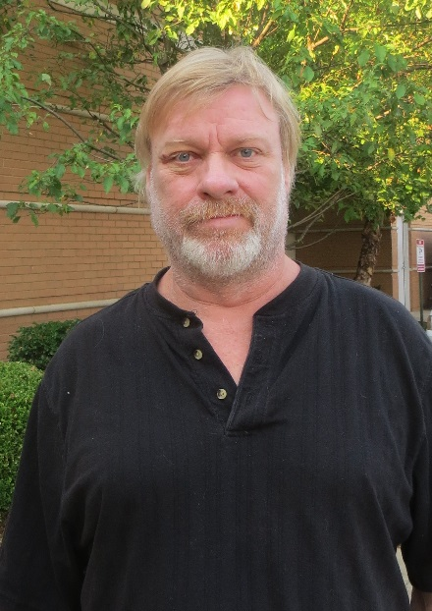
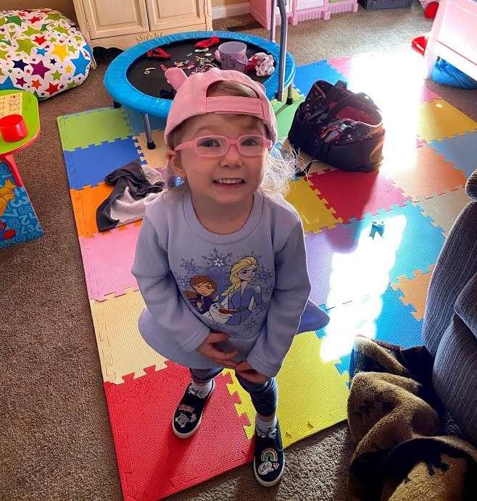
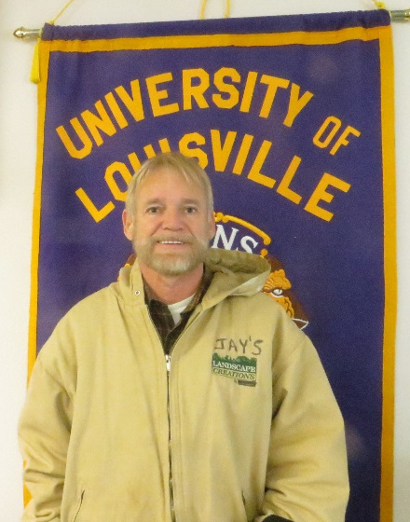
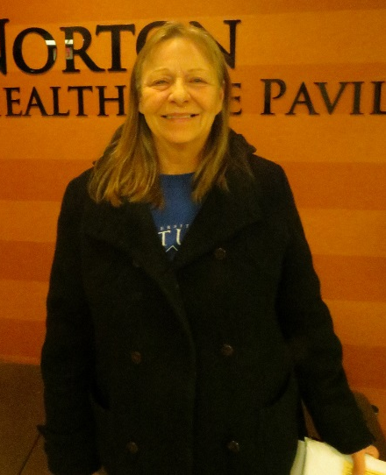
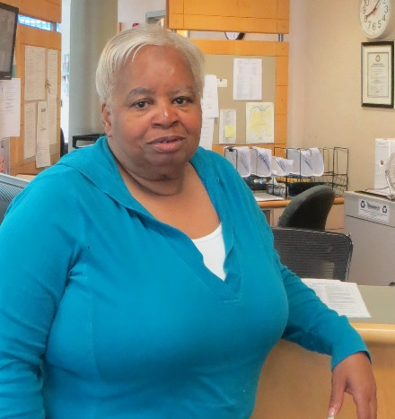
Patron Trust Program
.
The Patron Trust Fund assists low-income Kentuckians in need of eye surgeries who have limited insurance. Requests for help will be considered by a committee of Lions Club members who have been selected to manage the Patron Trust Fund under the direction of the Kentucky Lions Eye Foundation.
During the Fiscal Year 2024-2025, the Patron Trust Program approved to support 45 individuals by approving a total of $76,199 in financial support for their eye surgeries, special lenses, prosthetics or other procedures.
The pictures below are of several recipients who have been supported by the Patron Trust Program.
Page 44

Slide 45
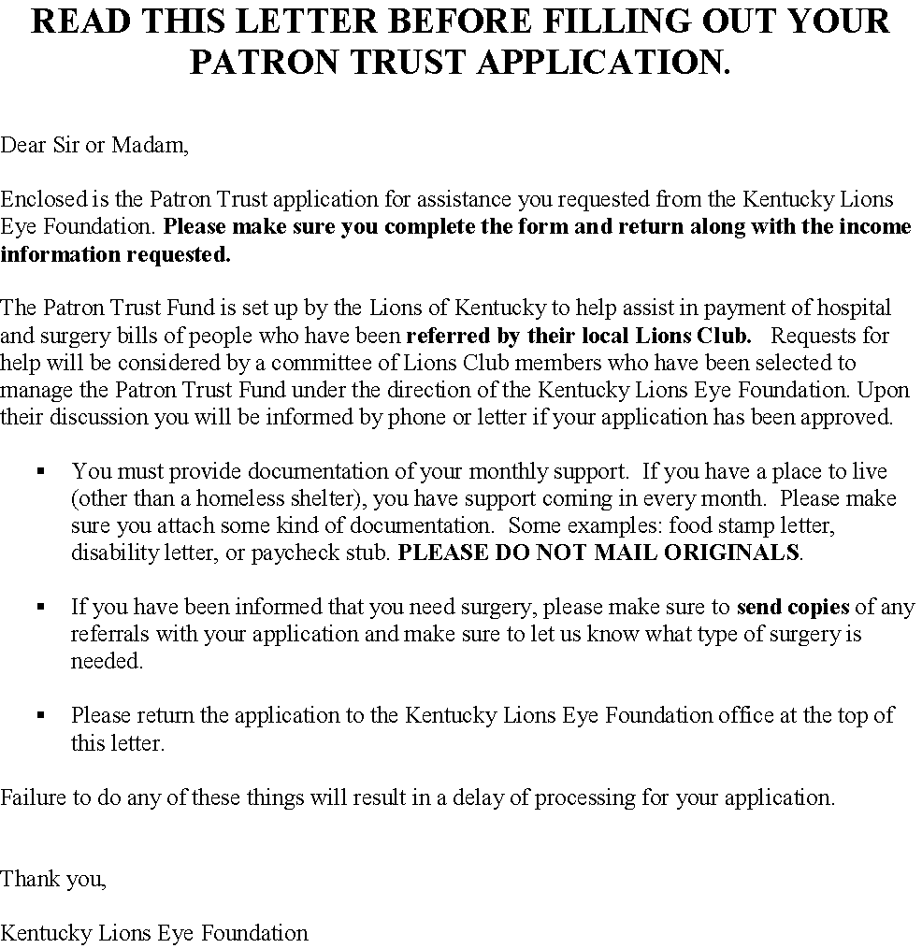
Patron Trust Program Application
Page 45

Slide 46

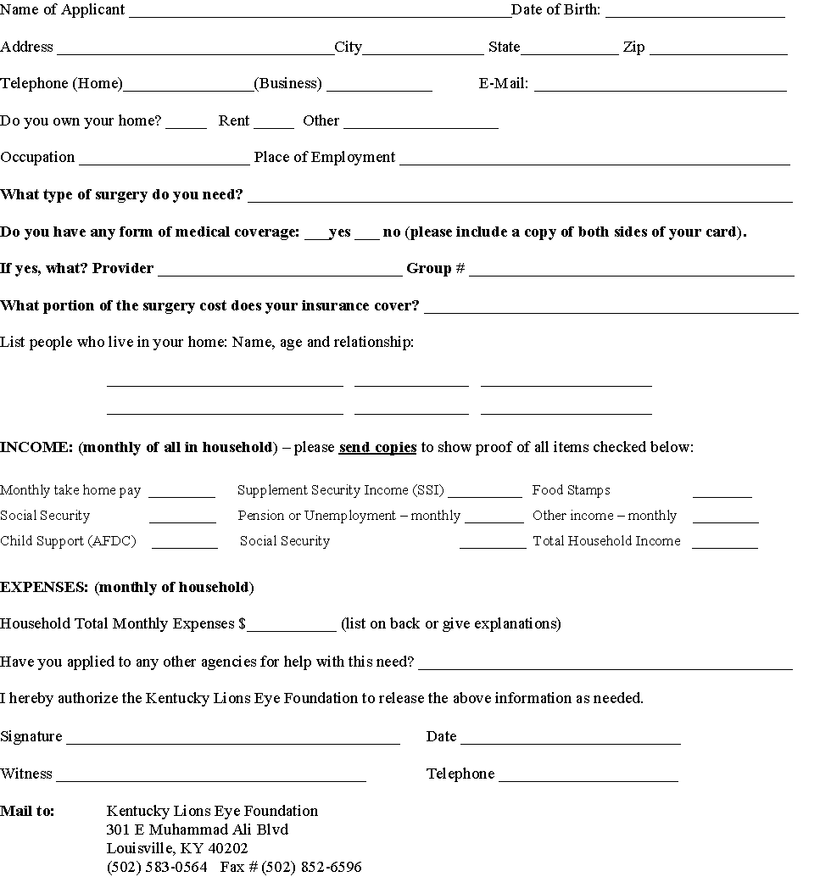
Page 46

Slide 47
Vision Van Program
Through the Vision Van Program, KLEF is pleased to provide the resources (two vans, equipment, supplies, training, consultation, supervision, etc.) to the Lions clubs in Kentucky’s Multiple District 43 for the purpose of conducting vision screenings. Since 2002, the Vision Van program has provided 262,335 FREE vision screenings in Kentucky.
For recording purposes, any vision screenings provided by a SPOT camera on a person over the age of 6 will be recorded as a Vision Van screening, even if this child is screened during a “KidSight” screening. Please keep separate records of anyone over the age of 6 and submit a Vision Van Screening Cover Sheet Report (see next page).
Vision screening is never as comprehensive as a doctor’s examination and can never be a substitute for seeing an eye doctor. Screening procedures may detect people in early or treatable stages of eye disease: some who are at high risk for eye disease; and/or have refractive errors. Screeners urge these people to seek professional examinations. We, as screeners, have the opportunity to help vision professionals save the sight of people who might otherwise neglect seeing an eye doctor until it was too late.
Approximately one-third of adults will fail a vision screening and need to see an eye doctor. In low-income senior groups, the failure rate can be as high as 50%. The strategy in screening programs is:
(1) To target high risk groups
(2) Urge them to participate in a vision screening, and, if in need, obtain an examination.
(3) Suggest they see their eye doctor on a regular basis
KLEF Vision Van Stations:
(1) Interview and registration
(2) Check Acuity (near and far vision)
(3) Visual fields
(4) Intraocular pressure testing
(5) Exit interview with results, questions, brochures, and determining need for assistance.
Plan a screening for your community: To request to use the Vision Van please call 502-583-0564 or put in a request online by visiting www.kylionseye.org/vision-van. The Vision Van equipment is to be used indoors and all equipment needs an electrical supply.
• Select a date, time and place (call KLEF at once to confirm)
•Set up driver to pick up the Vision Van from the KLEF office in Louisville and return it to KLEF after the screening
• Publicize the event
• Recruit volunteers
• Arrange training for volunteers
• Serve as a liaison with KLEF
KLEF does not charge to use the Vision Vans. However, if a Club, individual or business wants to make a donation toward the Vision Van Program, the funds will help ensure the continuation of this important program and help defray any extra expenses.
Page 47

Slide 48
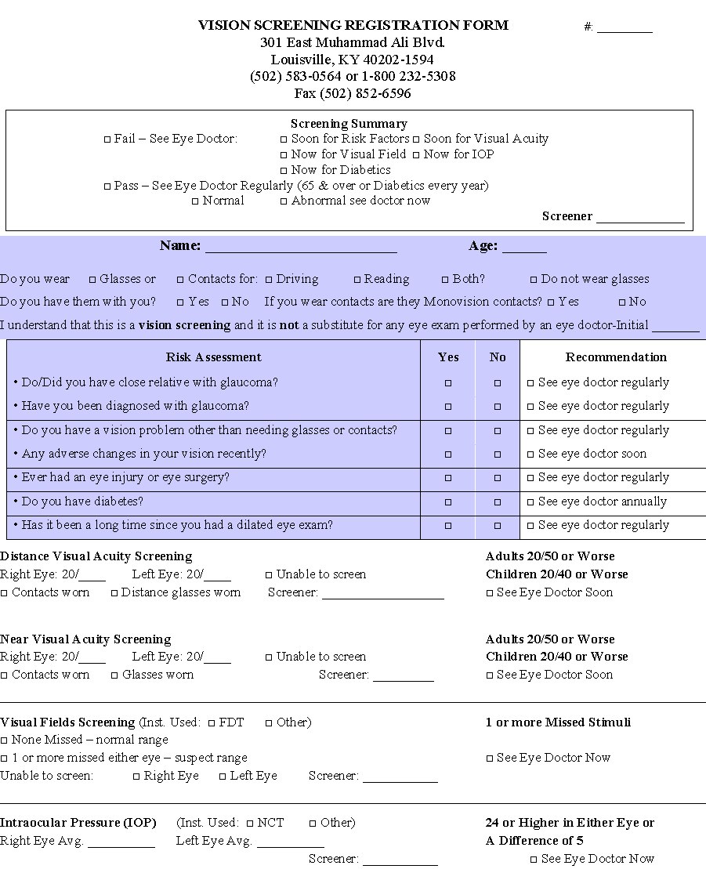
Page 48

Slide 49
Vision Van Spot Camera Vision Screening
Ages: 7 years old to Adults
A. Vision Screening Site Information (PLEASE PRINT)
1. Date: ______________________________
2. Name of Screening Site: _____________________________________________
3. Address: _________________________________________________________
4. City & Zip Code: ____________________________________________________
5. County: ___________________________________________________________
6. Contact Person: _____________________ E-mail: _________________________
7. Phone: (___________)________________________________________________
B. Preliminary Screening Results
Total Number Screened: ______ Passes_____ Referrals_____
C. Lions Club Information:
1. Lions Club Contact: ____________________________________________
2. Address: _____________________________________________________
3. City & Zip Code: ______________________________________________
4. County: ______________________________________________________
5. Lions Club: ____________________________ District: ___________
6. Telephone Number: ____________________________________________
7. Total # of hours including travel time: ______________________________
Please send the Cover Sheet to:
Kentucky Lions Eye Foundation, Vision Van Program
301 E Muhammad Ali Blvd.
Louisville, KY 40202-1594
Phone: (502) 583-0564
Fax: (502) 852-6596
Page 49

Slide 50
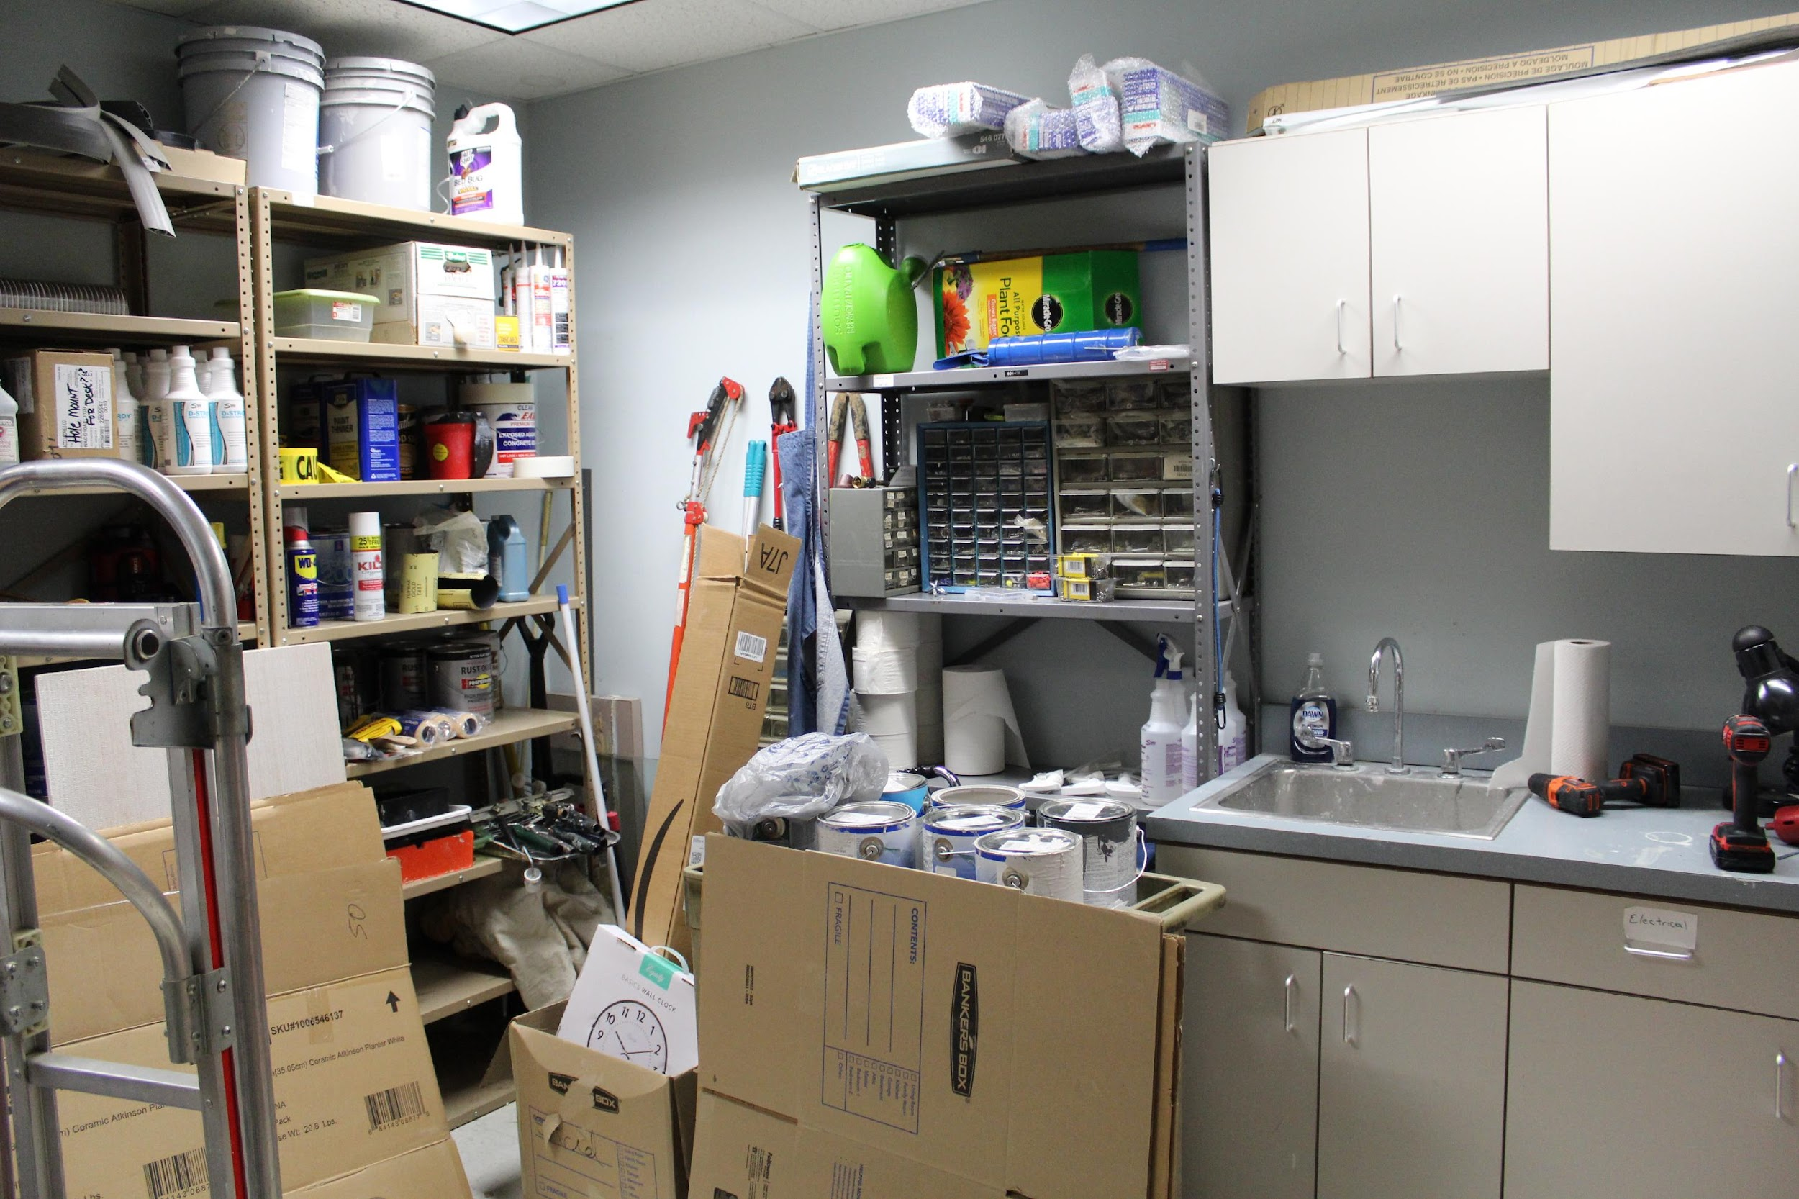
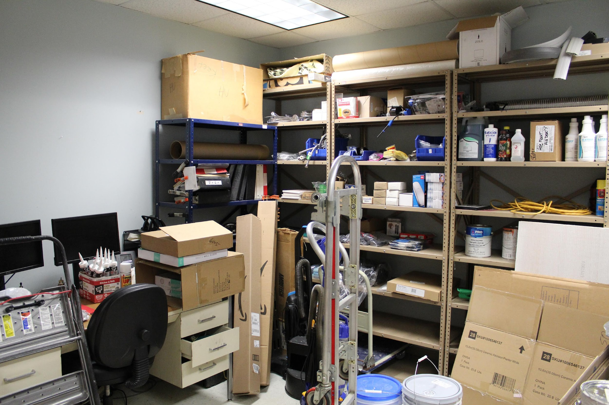
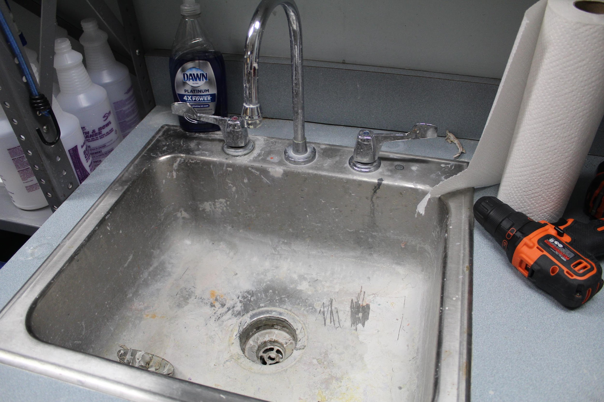
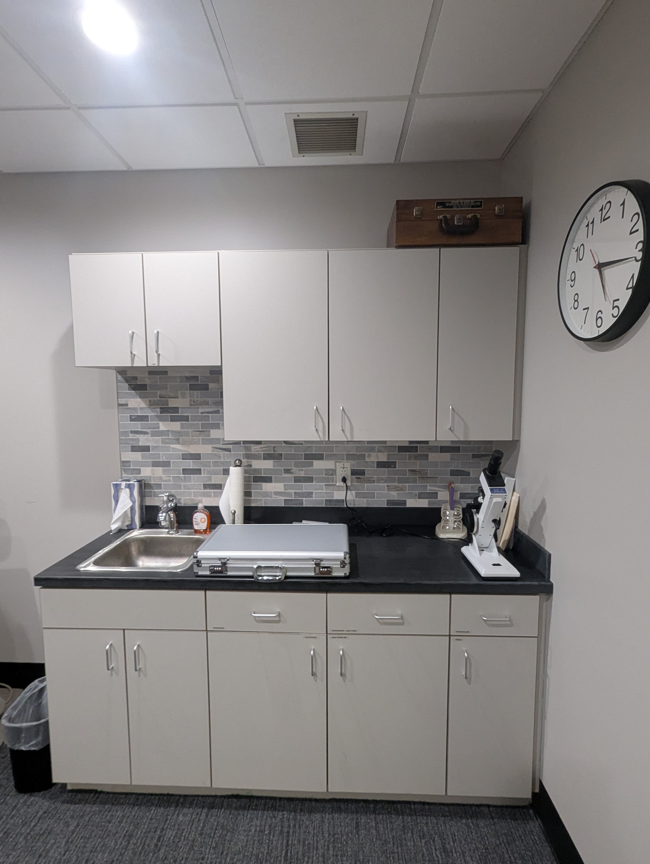
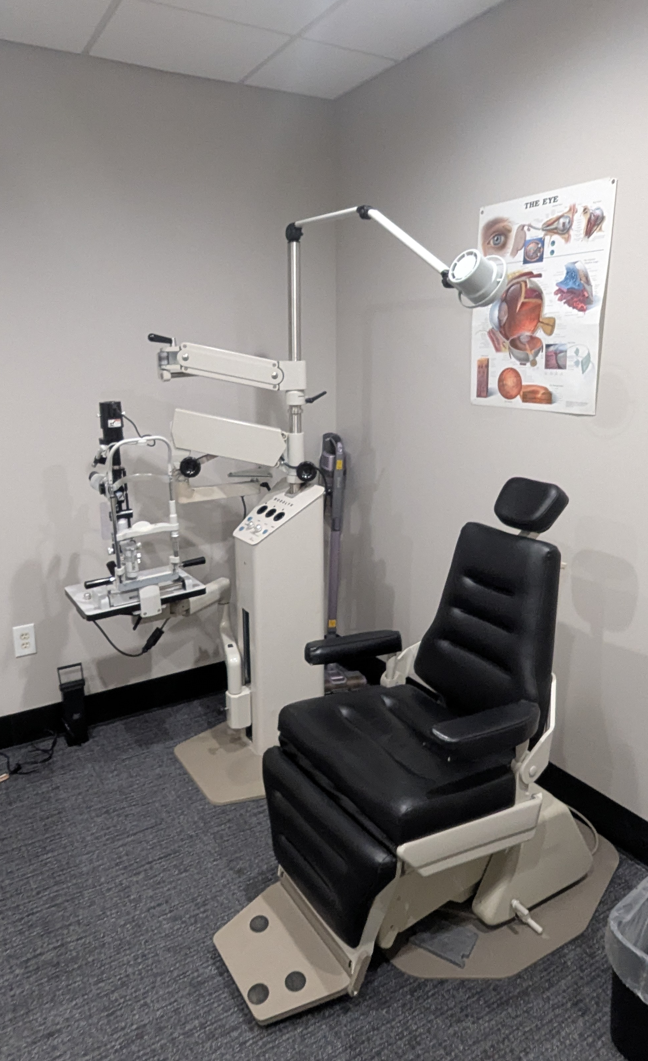
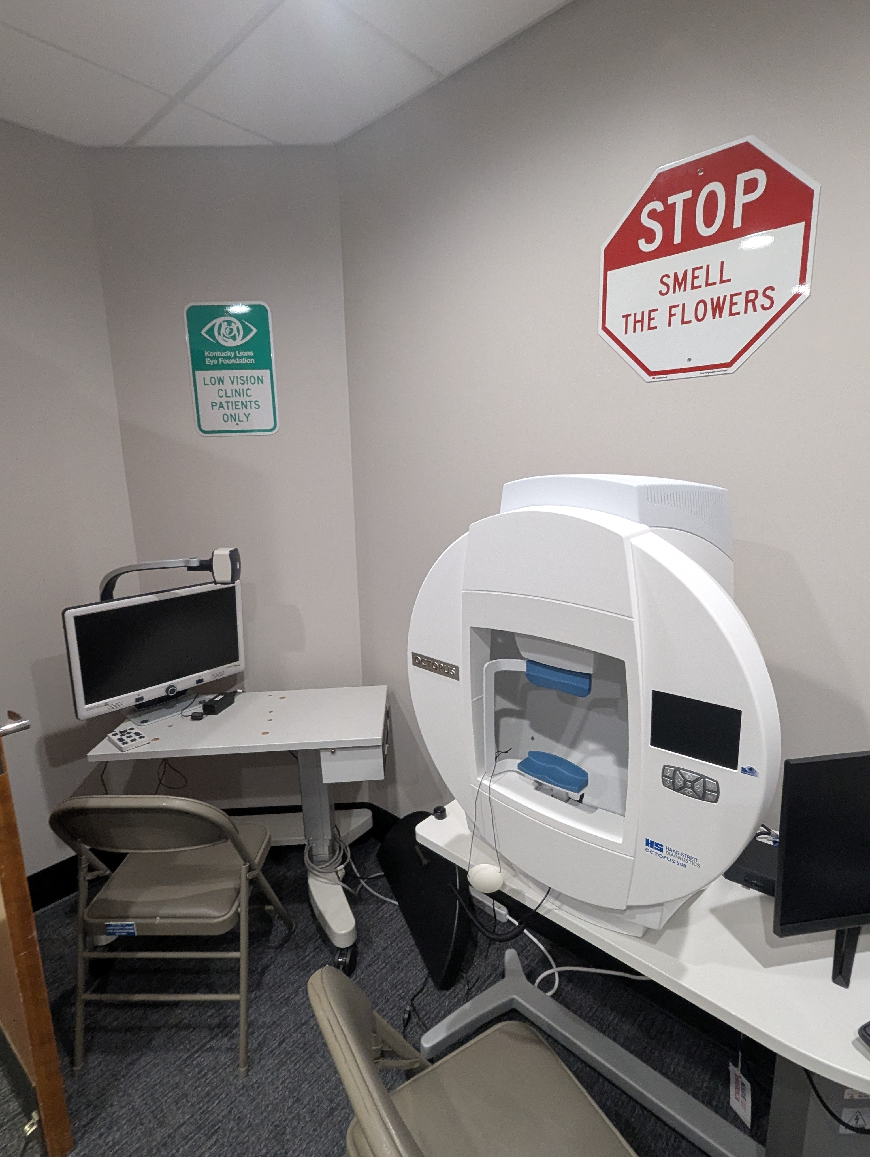
Low Vision Clinic
.
In May 2023, KLEF announced our intention to open a new Low Vision Clinic that will be managed by KLEF at the McDowell Center in Louisville. This Clinic is made possible through donations and collaborative partnerships with several organizations, including support from the Louisville Downtown Lions Club, Kentucky School for the Blind Charitable Foundation, Adam & Carla Ruschival and others.
Below are some pictures of the exam room in July 2023; the room was used as a maintenance room for 12+ years so there was a good amount of work that needed to be done to prepare it and the reception area to function well as the Low Vision Clinic.
After renovations of the space were completed in July 2024 and the necessary equipment and supplies were obtained, KLEF proudly opened the Low Vision Clinic in November 2024. Below and on the next page are some pictures of the renovated exam room and reception area of KLEF’s Low Vision Clinic.
Page 50

Slide 51
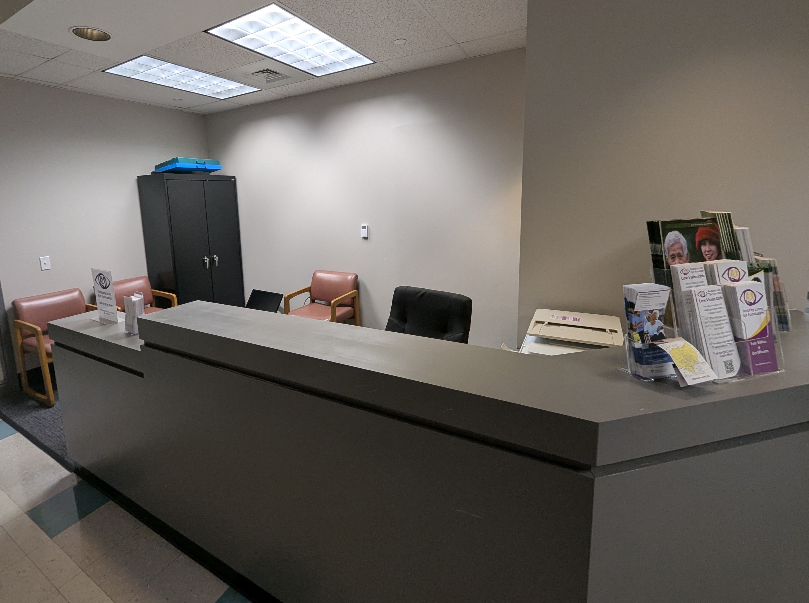
Low Vision Clinic
.
The Clinic provides services to low vision individuals who have goals they would like to achieve to enhance their quality of life, and the low vision services provided at the Clinic are a great addition to the services that KLEF provides.
Low vision exams will be provided to any resident of Kentucky or a surrounding state who is living with low vision. Insurance is not required and we serve all, regardless of age, gender, income or other factors.
During the pilot phase from November 2024 through July 2025, the Low Vision Clinic was open to see patients two days per month. Beginning in August 2025, the Clinic will be expanded to being open three days per month to serve more individuals in need.
So far through July 2025, KLEF has provided no-cost comprehensive evaluations to 88 individuals with significant vision impairments who are considered Low Vision. Patients have ranged in age from 6-99.5 years; men and women; working and retired; patients self-referred and referred by their eye doctor; patients with Macular Degeneration, Diabetic Retinopathy, Diabetic Macular Edema, Glaucoma, Keratoconus, Nystagmus, and more. We are working on many additional referrals to the Clinic, and we receive new referrals regularly.
This new clinic is a beacon of hope for individuals with low vision. Many patients have entered the Clinic room depressed or anxious, but they have left feeling hopeful and positive about the future; sadness and uncertainty has been turned into happy tears and restored hope and positivity. There’s been a patient who thought she could never quilt again who left thrilled she could resume one of her favorite hobbies; a patient in tears of joy for the restored hope she felt thanks to the Low Vision Exam and the possibilities she now sees; a patient ecstatic to see his wife again with the assistance of some recommended devices during his exam- something that was not possible for years! The sincere exhilaration in their voices, their gratitude, and their happiness is tremendous to witness and provides strong affirmation of the impact our clinic is having on lives already!
KLEF hopes to serve at least 200 individuals with no-cost low vision evaluations in the 2025-2026 fiscal year thanks to the generosity of our supporters and the dedication of our staff. We want to ensure sustainability of this important program for many years to come!
If you would like to learn more or to make a contribution toward the Low Vision Clinic, please visit kylionseye.org/lowvision.
Page 51

Slide 52
2025-2026 KLEF Quick Reference Guide
We hope you find this Quick Reference Guide to be a useful tool.
As a Trustee, you may receive inquiries at times about KLEF programs, services, general operations, etc. If you find that you are not able to answer any question or need more information about a certain topic, please use this reference guide as to who to direct your question(s) to.
Lindy Lamkin LindyL@kylionseye.org 502-299-7483 (cell) | Karen Hayse KarenHayse@kylionseye.org 502-553-1947 (cell) | Jennifer Hunt Spurling JenniferHunt@kylionseye.org 270-999-4887 (cell)
KLEF Operations / Procedures | KidSight Program | Communications (Newsletters, Social Media, KLEF Website, Etc.)
Legal / Financial / Personnel / Board of Trustees | Holloran Trust | Patron Program
Collaborative Partnerships / Low Vision Clinic | Finis Davis Fellowship | Vision Van Program
Development (Grants, Bequests, Corporate Donations, Fundraising Opportunities, Etc.) | Kentucky State Fair | Events (Mr. & Miss KY Basketball Banquet, Golf Scramble, Etc.)
Thank you for your commitment to being a KLEF Trustee and for your support of our mission, programs, and staff!

